Slide 1
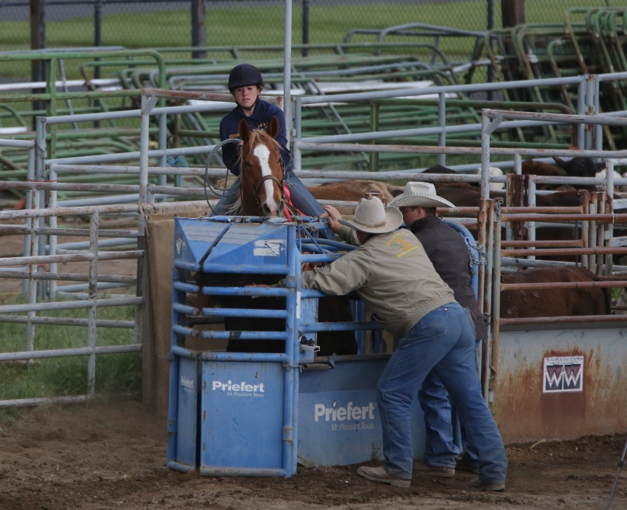
OHSET Excellence in Equestrian Athletics Team Management and Rules
2023 Coaches & Advisors Training

Slide 2
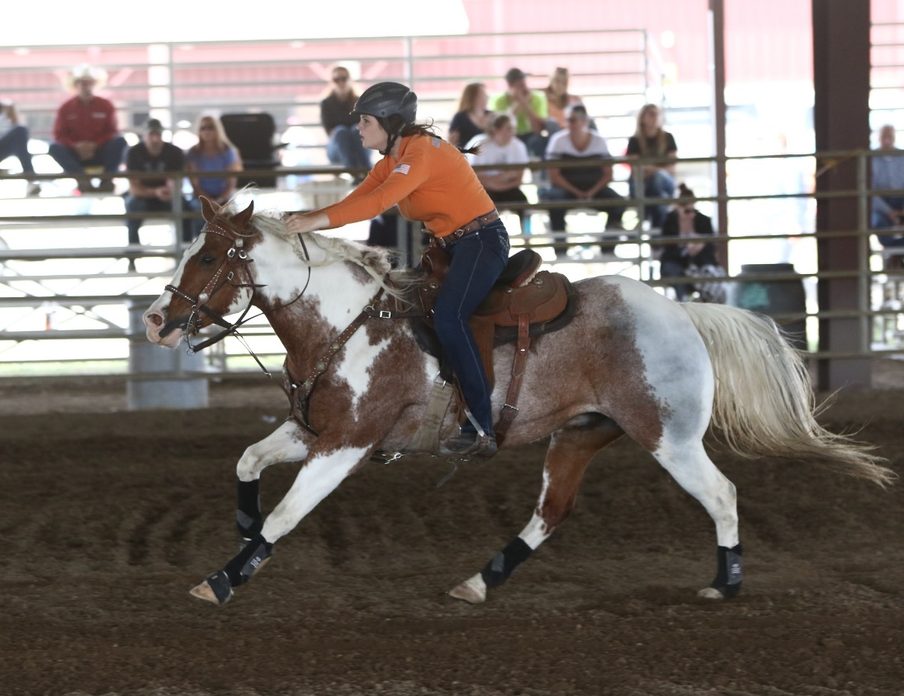
Informational Meeting
OHSET Mission Statement
Athlete/Parent Expectations
Varsity Sport
Team Rules
Fees
Coaching Philosophy

Slide 3
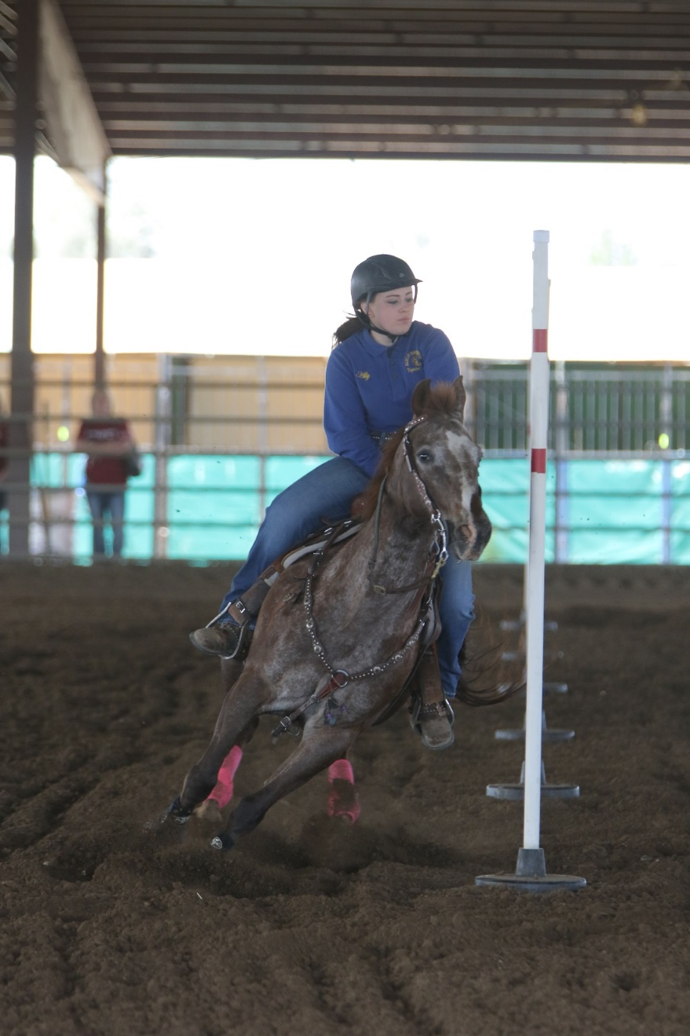
Athlete Expectations
Academics
Team Meetings
Goal Setting
Practices
Code of Conduct

Slide 4
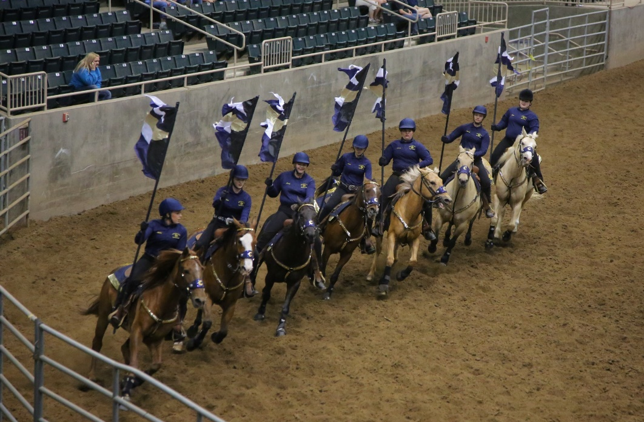
Parent Expectations
Role at practice
Invited Trainers
Parent/Athlete/Coach Leadership
Meet Expectations
Volunteer to work events
Parent Jobs
Uniforms
Fundraising
Cook/food room
Treasure

Slide 5
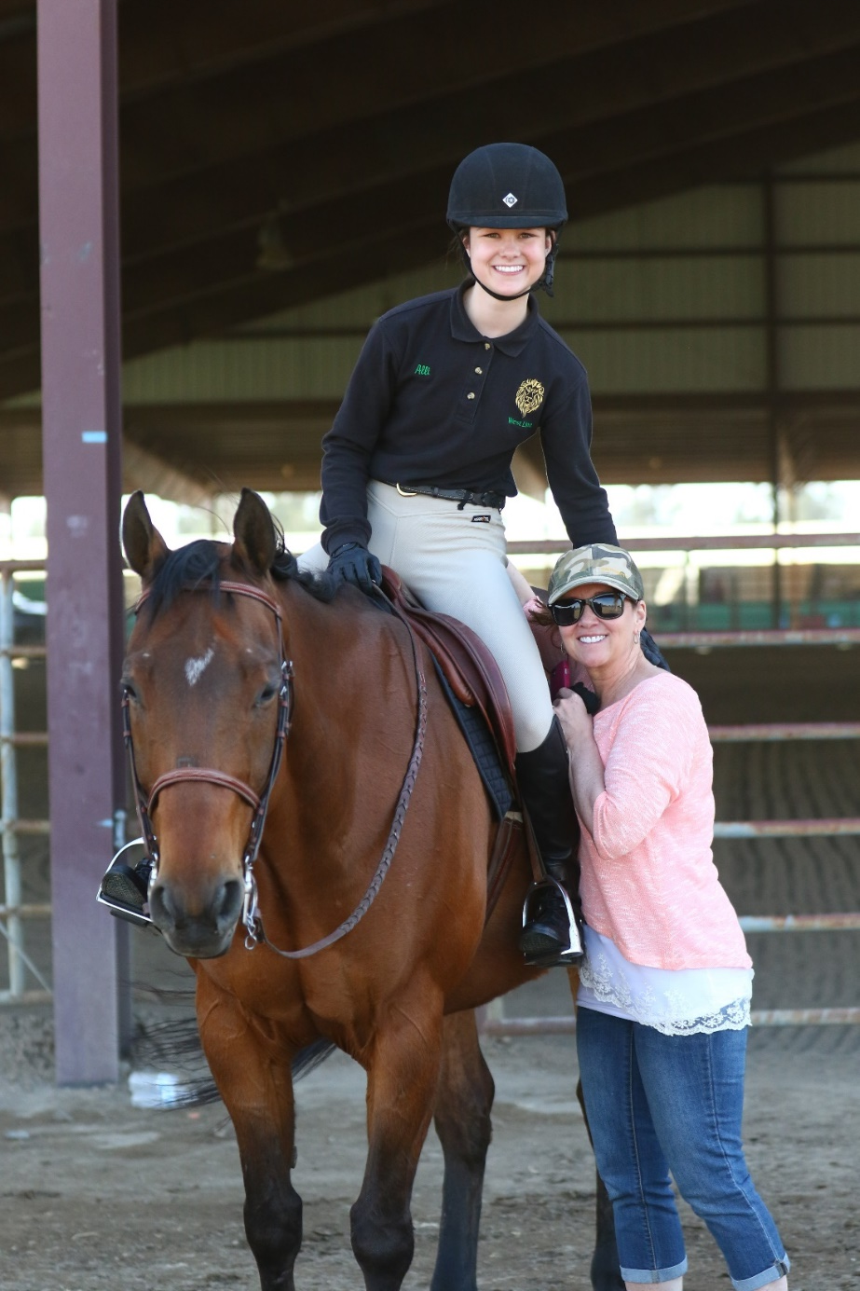
Team Leadership
Coaches Role
Practice
Choosing teams/tryouts
Sportsmanship
Advisors Role
Registration
Conflict resolution
Team building
Chain of Command
Team Captain
Coach/Advisor
School
District Chair
State Chair

Slide 6
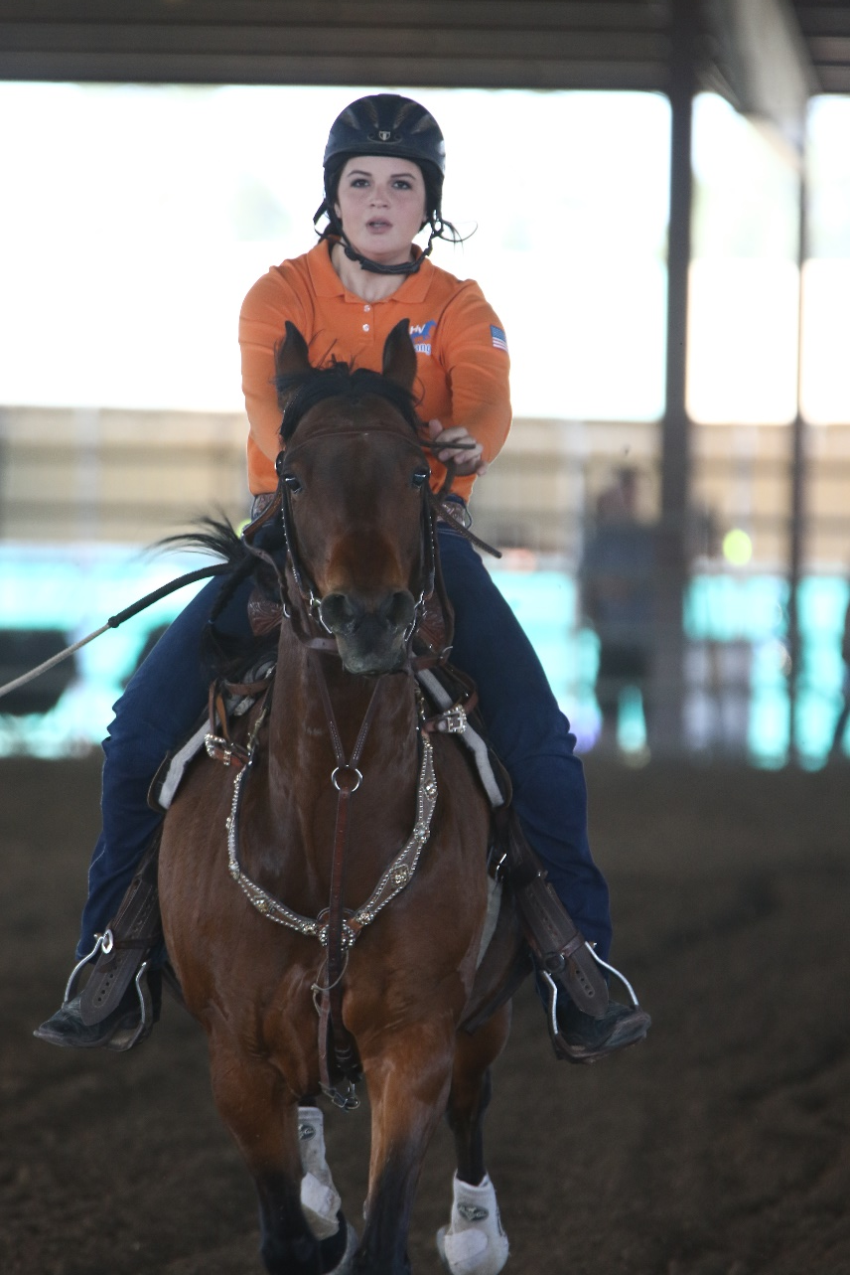
Practice Expectations
Where, When, Cost, Mandatory
What to expect at a practice
Who can ride
All registered athletes and grooms
Coaches if space allows
No family members or potential athletes
Registered coach 21 years or older MUST be at all practices
Invited trainers/volunteers

Slide 7
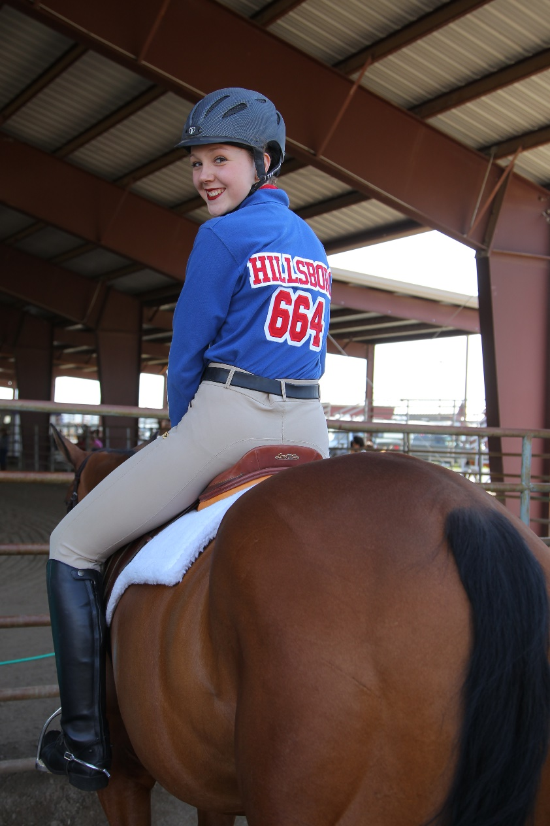
Lettering Requirements
Schools Requirements
Examples of Team Requirements
Qualify for state
Varsity points counted for team
Years in OHSET
No Code of Conduct Violations
Participation
Coaches/Advisors Decision

Slide 8
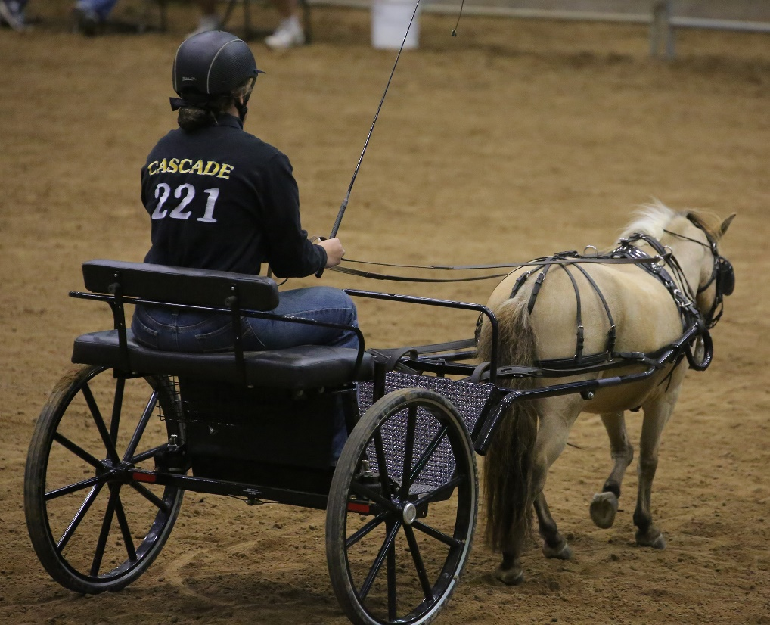
Safety: Must be a Priority
Helmets and boots required for all mounted or driving athletes
Skill level of horse and athlete
Coach has the right to say no
Coach should evaluate each event before a meet
Coach has the final say
Animal’s health
Report all accidents

Slide 9
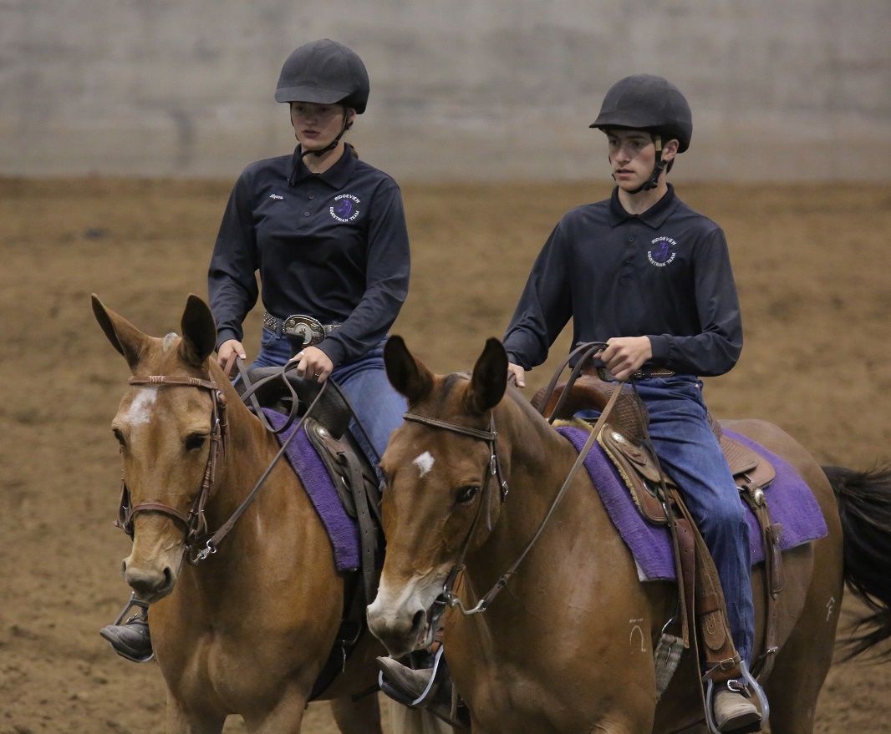
Team Meet Expectations
Athlete requirements
Parent requirements
Event requirements
Who can make class changes
Athlete supervision
Support team members

Slide 10
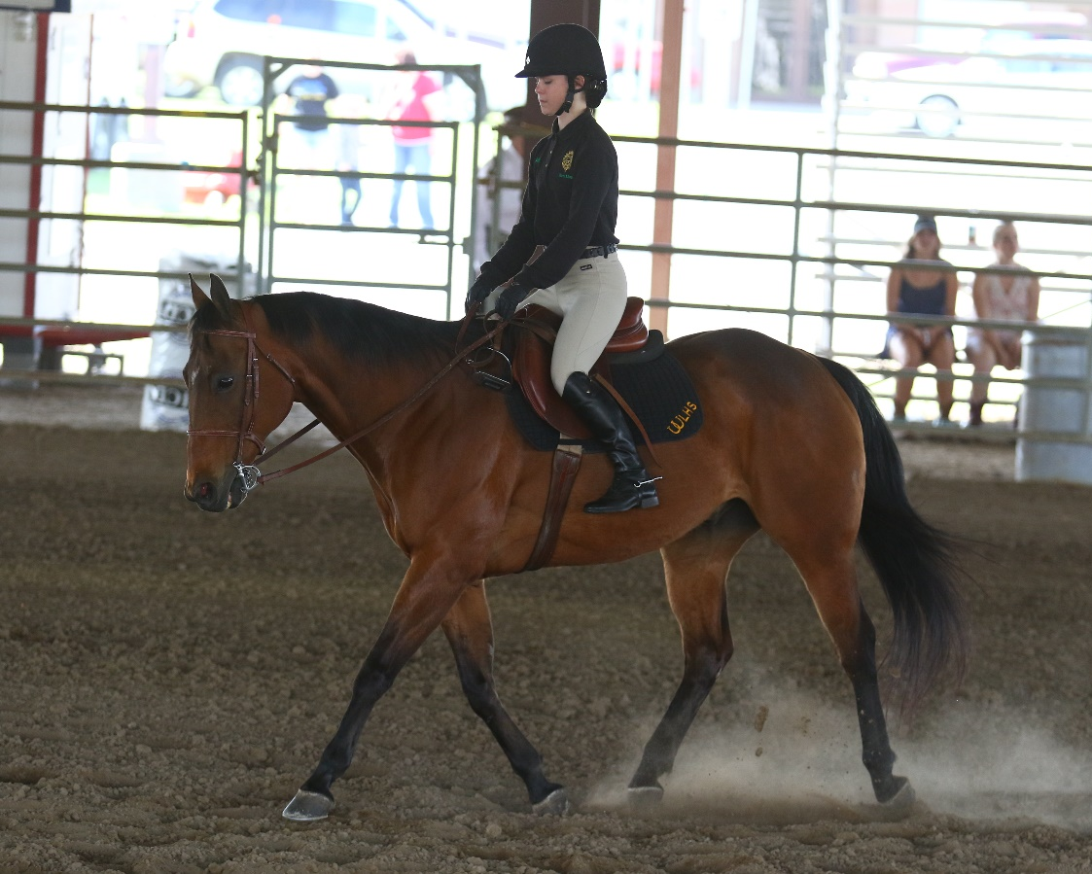
Things to keep in mind
A good working relationship between the coach’s and advisor is critical. Solid leadership will trickle down to the rest of the team.
Coach and Advisor do not have to do everything…DELEGATE
Goal setting is a great tool for learning throughout the season.

Slide 11
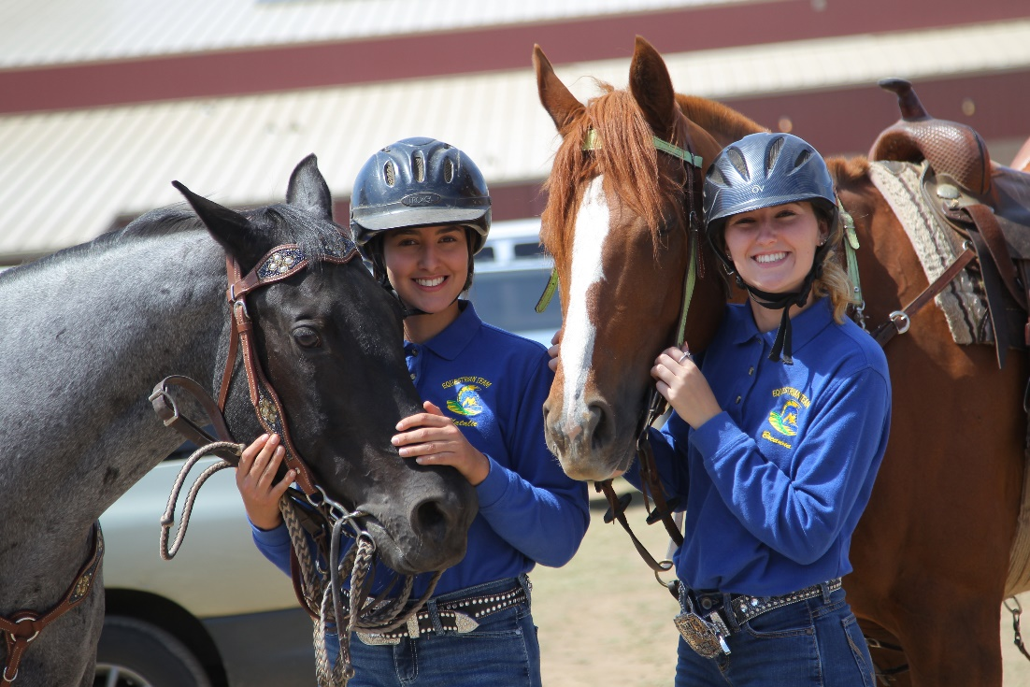
Things to keep in mind
Safety should be your first concern.
Use the resources available to you: other Coaches, District officers, Rule book, Hand book, State officers.
Be supportive to all athlete needs.

