Slide 1
State Insurance policy and Additional event insurance

Slide 2
State insurance policy
Policy runs from November 1st to Oct 31st and covers
practice arenas, meet arenas, business meeting facilities
if they have been included
on the policy either at renewal
or added during the year.

Slide 3
This is a Liability policy and covers damages to facilities caused by an OHSET athlete, horse or registered volunteer.
This does not cover athlete/horse/registered volunteer injuries.

Slide 4
Per our policy
NO dogs are allowed at practices or meets where there are horses.
Not even little cute ones that fit in a purse!

Slide 5
Unless they are service dogs which are allowed.
If a service dog is creating an issue in the arena or barn
you can and should ask them to relocate away from the equine.

Slide 6
If you need to have an arena or school added to our policy
once the season has begun, notify your District Chair.
They will need to know:
Arena Name, Owners Name, Arena Address, Mailing Address,
Email Address and if they need to be named as an additional insured.
If they don’t need to be named as an additional insured once your District Chair receives the information, they can send you the blanket policy certificate.

Slide 7
REMEMBER:
Please remember our policy does not cover Parades, Rodeos and Pony Rides!
And no dogs anywhere there are horses!

Slide 8
Does our event need insurance?

Slide 9
Remember:
If the OHSET name, logo or banner is used in any event, it needs insurance
If the function is open to the public and is an "at will" community event,
no mention of OHSET, anyone can attend and there is no need for insurance.

Slide 10
Our team needs insurance now what do we do…..
Go to the OHSET web page at OHSET.com
click on Resources/Registration and Forms/Additional Event Request
and complete the application

Slide 11
As indicated on the application, the exact dates of all events hosted by you or are being hosted for your team's benefit must be declared in writing and approved by the insurance company in advance of the event date for coverage for that event. This needs to be completed early as possible, as it can take several weeks to get coverage.

Slide 12
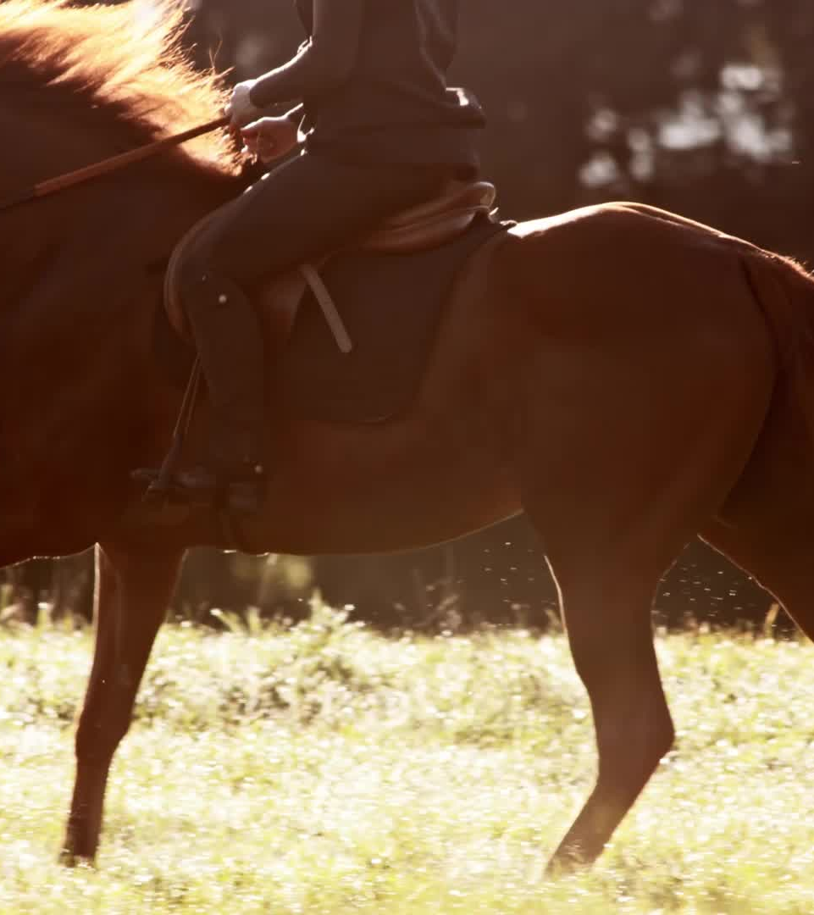
Events requiring prior notification include, but are not limited to, on or off-premises clinics, sanctioned or not-sanctioned horse shows, gymkhanas, some non horse fundraisers, etc. that are hosted by you or hosted for your benefit. Events that you attend but do not host do not require prior written notice and approval.
Please remember our policy does not cover Parades, Rodeos and Pony Rides!
And no dogs in arenas or barns!

Slide 13
Once you have completed this form, please
e-mail a scan of the form to djohn@ohset.com
and it will forward to our agent for approval. Once approved you will receive a certificate for your event.

Slide 14
Please be sure to notify me as early as possible, as some types of events may require an additional application supplement to be completed. Additionally, not all events may qualify for coverage. Early notification will allow our insurance company the time needed to make other coverage arrangements if your event does not qualify for coverage under our liability policy.

Slide 15
The first part of the form is your team information and the person in charge of the event
Applicant:
Email Address:
Mailing Address:
City:
State: OR
Zip:
Phone: Fax:
Contact Person:

Slide 16
In this section you enter the event information.
Event/Show date(s) Description of Event::
Location of event:
Description of event activities:
Average number of competitors per Show / Event:
Average number of spectators per Show / Event Day:
Maximum number of competitors:
Maximum number of spectators:
Sanctioning Organization(s): ie: OFEA, OQHA, WHO ect.

Slide 17
Use this section only if the arena, owner, school etc need to be named as an additional insured. You do not need to name your team here.
List Additional Insureds with relationship descriptions. For example: land owners and/or owners of facilities leased, sponsors of events, etc.
Name: Address: Relationship:
1.
2.
3.

Slide 18
The final section is your signature and date. This is very important as the application can not be processed with out it.
Must be signed and dated)
Insured’s Signature:
Print name: Date:

Slide 19
What does this cost and how do we pay for it?
Normally it is $45 per day but depending on the event that could increase the cost.
Addition insured is $20 per name.
Once State is billed for the coverage your district will be billed. Your district is responsible for billing the team.

Slide 20
We need to cancel our event
How do we do this?
There is no form for this notification so please just send an e-mail to me and I will notify our agents.
Events that have been cancelled or rescheduled must be made know to our agent within one week of the original event date scheduled, and before the makeup date occurs.

