Slide 1
SAFETY IS NO ACCIDENT Your Team Emergency Plan
OHSET Coaches Training
Adapted from Pam Steinke

Slide 2
Be Prepared
Every OHSET team/district should have an Emergency Action Plan:
Anytime or Any place.
Injury or Illness
Preparation is the key
Consider the different needs for where you plan to practice or compete.
Everyone has the Emergency Action Plan

Slide 3
What You Need to Know:
Layout of your practice facilities
Equipment
Support Personnel
Communication to HELP

Slide 4
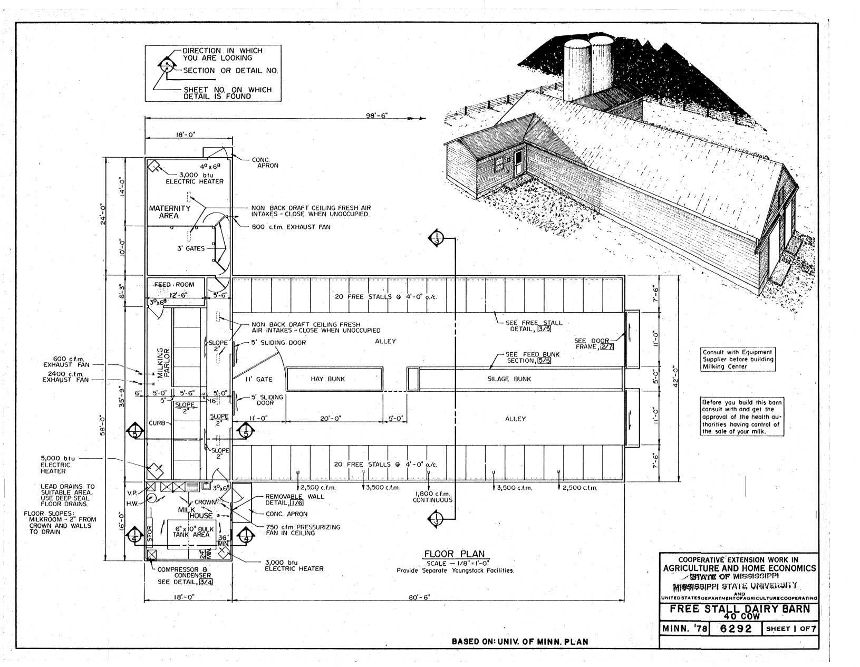
Facility Plan

Slide 5
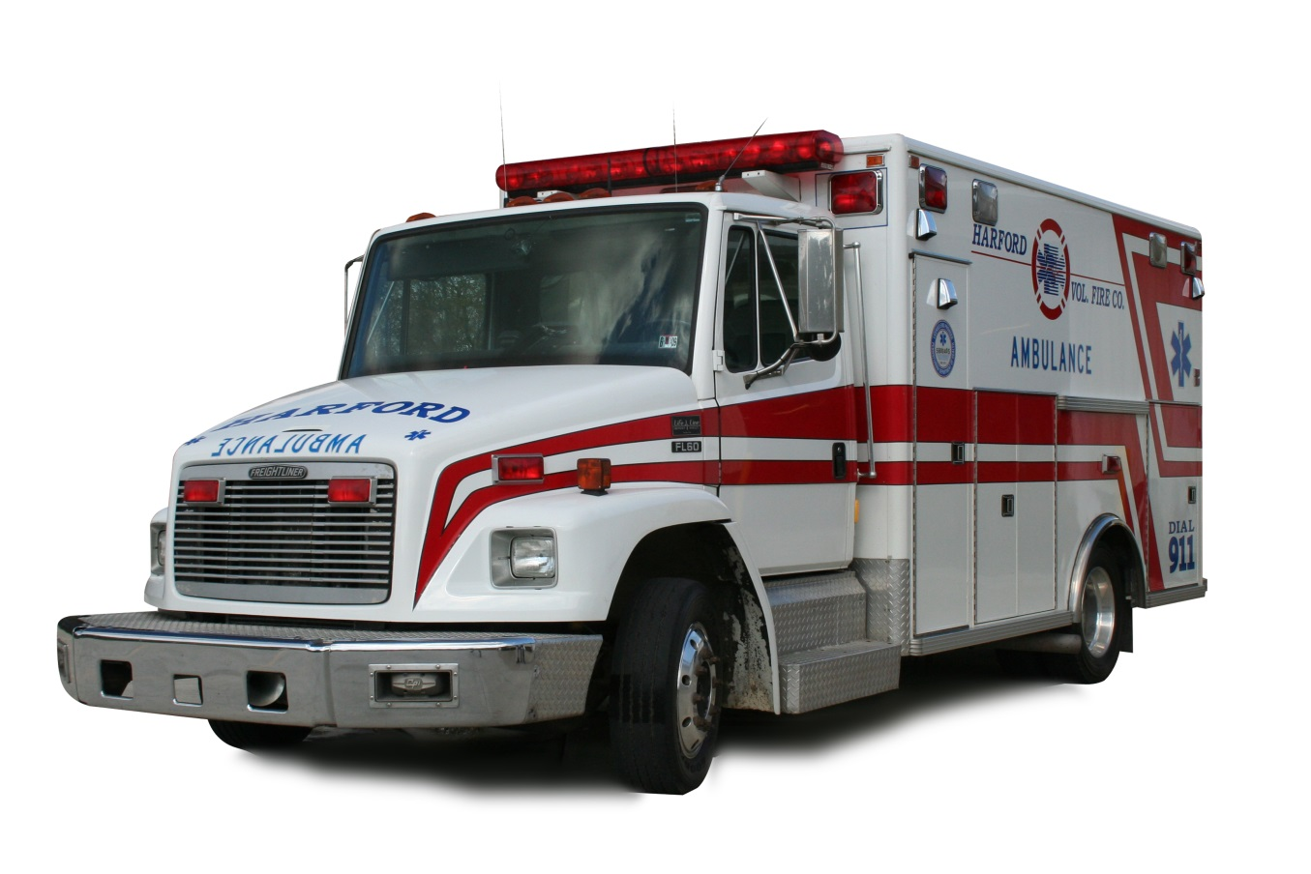
Where will EMS Enter & Exit?
Who will meet the ambulance and give exact directions
Know where access keys/codes are kept to open gates or doors

Slide 6
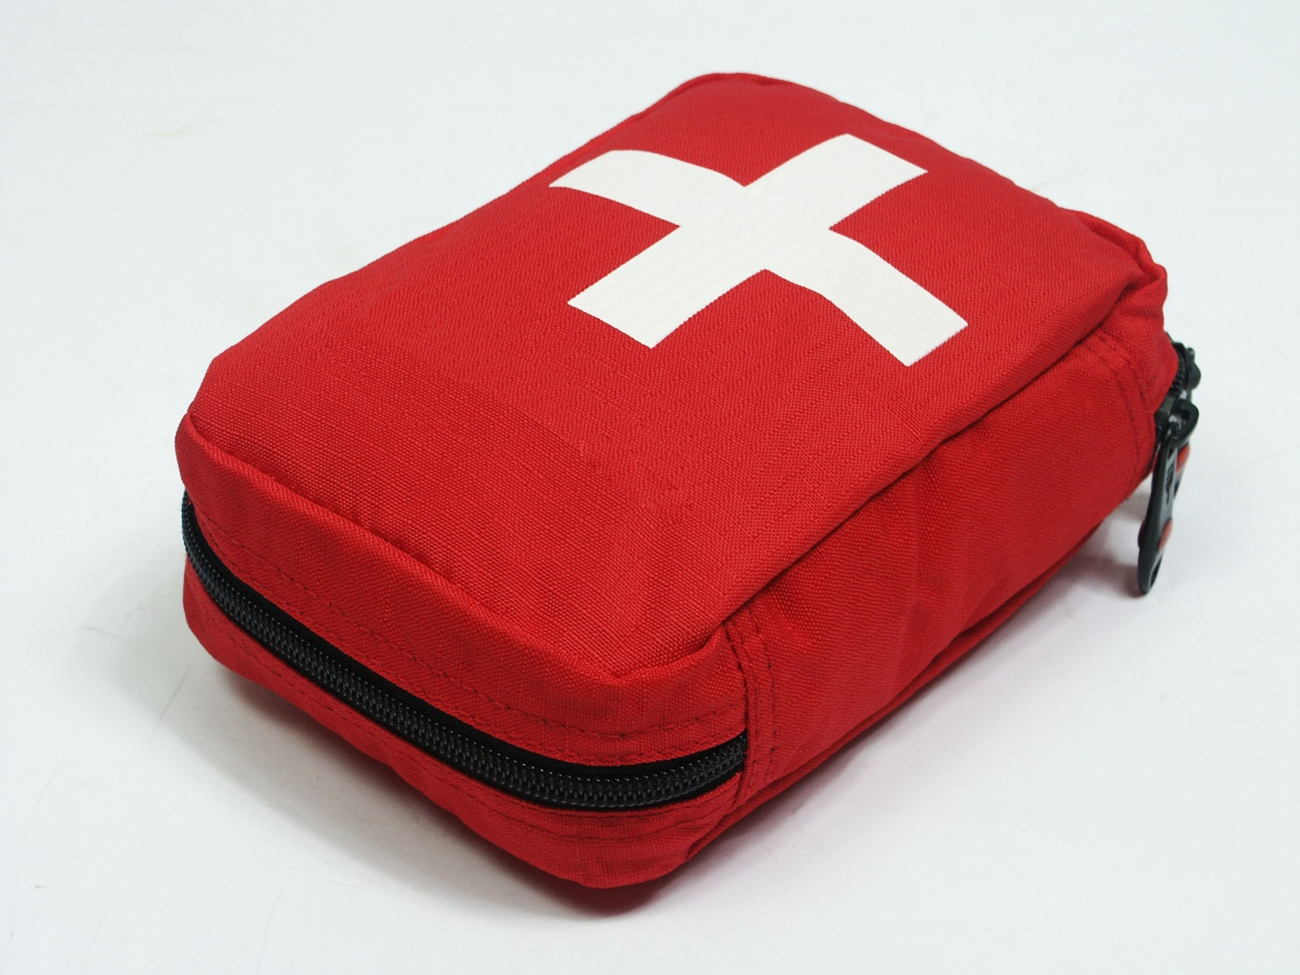
Know where First Aid Equipment and Fire Extinguisher is
AND be sure it’s up to date and re-filled

Slide 7
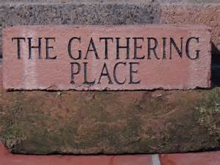
Designate a gathering place
Designate a gathering place for those not involved and a person in charge to keep them there

Slide 8
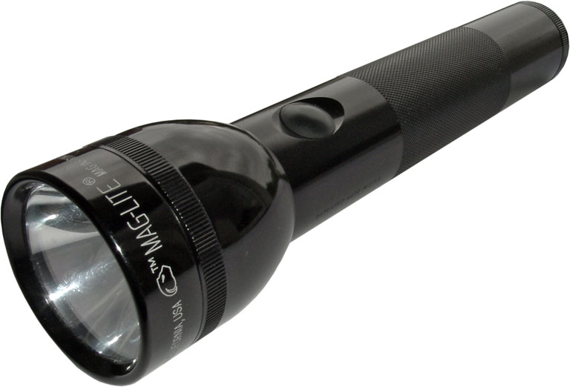
Other Needs
Stocked basic veterinary kit
Blanket
Flashlights with spare batteries
Contact numbers for team members
Notes:
First Aid stock list provided.

Slide 9
Support Personnel
Advisor
Head coach for the practice
Know resources from your membership
EMTs, Nurses, Doctors, Athletic Trainers

Slide 10
Communication
Be clear on how and when to call 911 or a local emergency number
The caller MUST have the basic information on the athlete and the injury (age, gender, how it happened, type of injury- head injury, broken leg, etc)
Notes:
If the advisor/coach at the incident must accompany an injured athlete the activity must be cancelled without appropriate supervision present

Slide 11
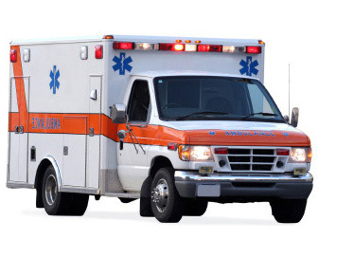
Send Someone…
to meet the ambulance and give exact directions.

Slide 12
More Communication
Create a chain of command within your team:
Designate person to contact the athlete or persons family
Designate person to contact the facility owner

Slide 13
The Emergency Phone Call:
“My name is ________
I am located at ________
One of our riders has been injured. They are ____ years old and complaining of ______
Please come to ____ someone will be at the entrance to direct you.
Notes:
Talk slowly and clearly. Be away from interruptions and distractions so you can answer questions and clarify when necessary.

Slide 14
Follow Up
Decide who is responsible for completing the appropriate injury forms. www.OHSET.com
Mail completed form to:
OHSET, c/o Jan Harer , 37285 SW Nature Dr., Cornelius, OR 97113 jharer@ohset.com
Evaluate the response and any gaps in your plan for future events.
Notes:
The OHSET injury form and contact information
www.ohset.com

Slide 15
COVID-19
Follow ALL guidelines – document on website
Sign in and out EVERY time
Report if a positive – Guidelines up on website soon
Stay Informed
Be Smart
Understand that how you handle this impacts entire organization, district meets, state championship and PNWIC

Slide 16
Coaches First Aid Kit
Non-powdered barrier gloves 2-3 pair
Rescue breathing face shield
Instant Ice Cold Pack
Elastic Fabric flexible bandages – 3-4 inch
Strip Band-Aids
Triangular Bandage for sling
2” Roller Gauze (or Coban)
Adhesive Tape
2x2” Sterile Gauze Pads
3x3” Sterile Gauze Pads
Telfa Non Stick Pads
Large Patch Bandage
Adhesive Tape
Alcohol / Disinfectant Swabs
Antiseptic Pads
Saline Eye Wash
Individual Tylenol/Advil
Neosporin Ointment
Scissors
Notes:
Ointment may contain xylocaine or pain relief agent.

Slide 17
Basic Veterinary Kit Yes we deal with horses – only with permission from owner
Thermometer, digital
Betadine solution and Betadine scrub
Wound salve/spray
Saline
Big syringe (or Turkey baster)
Gauze pads
Telfa pads (or other non-stick pad)
Rolled gauze
Sheet cotton
Standing wraps
Brown gauze
Vetwrap
White tape, water-proof
Sharp scissors (or Bandage scissors)
Hoof pick
Notes:
Recommended Equine First Aid Kit Extra Supplies
Clippers
Sterile lube
Latex gloves
Shoe pulling equipment/tools
Poultice
Needles and Syringes
Potential Drugs to Keep on Hand:
Banamine (Flunixin Meglamine) – strong analgesic & antipyretic. IV or IM. ~10cc
Bute (Phenylbutazone) – great anti-inflammatory
Electrolyte paste

Slide 18
Complete Your Emergency Action Plans!!

