Slide 1
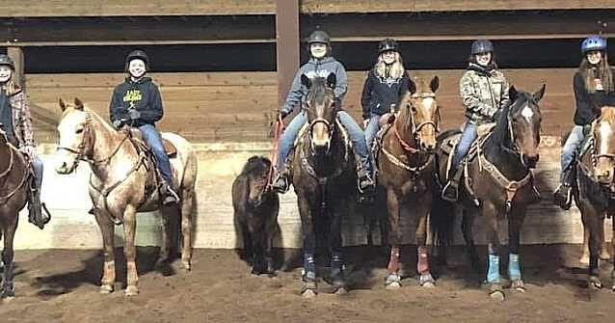
OHSET Practice

Slide 2
Team Practice
Establish expectations
Go over team rules
Practice Schedule
Team leadership roles
Equipment
Know your arena
November 18th.

Slide 3
Team Practice
Coach or Advisor 21 years of age MUST be present….
Registered athlete are the only ones that can ride.
Athlete information with you at all times.
Medical emergency plan.
A way of communication.
KNOW your Facility

Slide 4
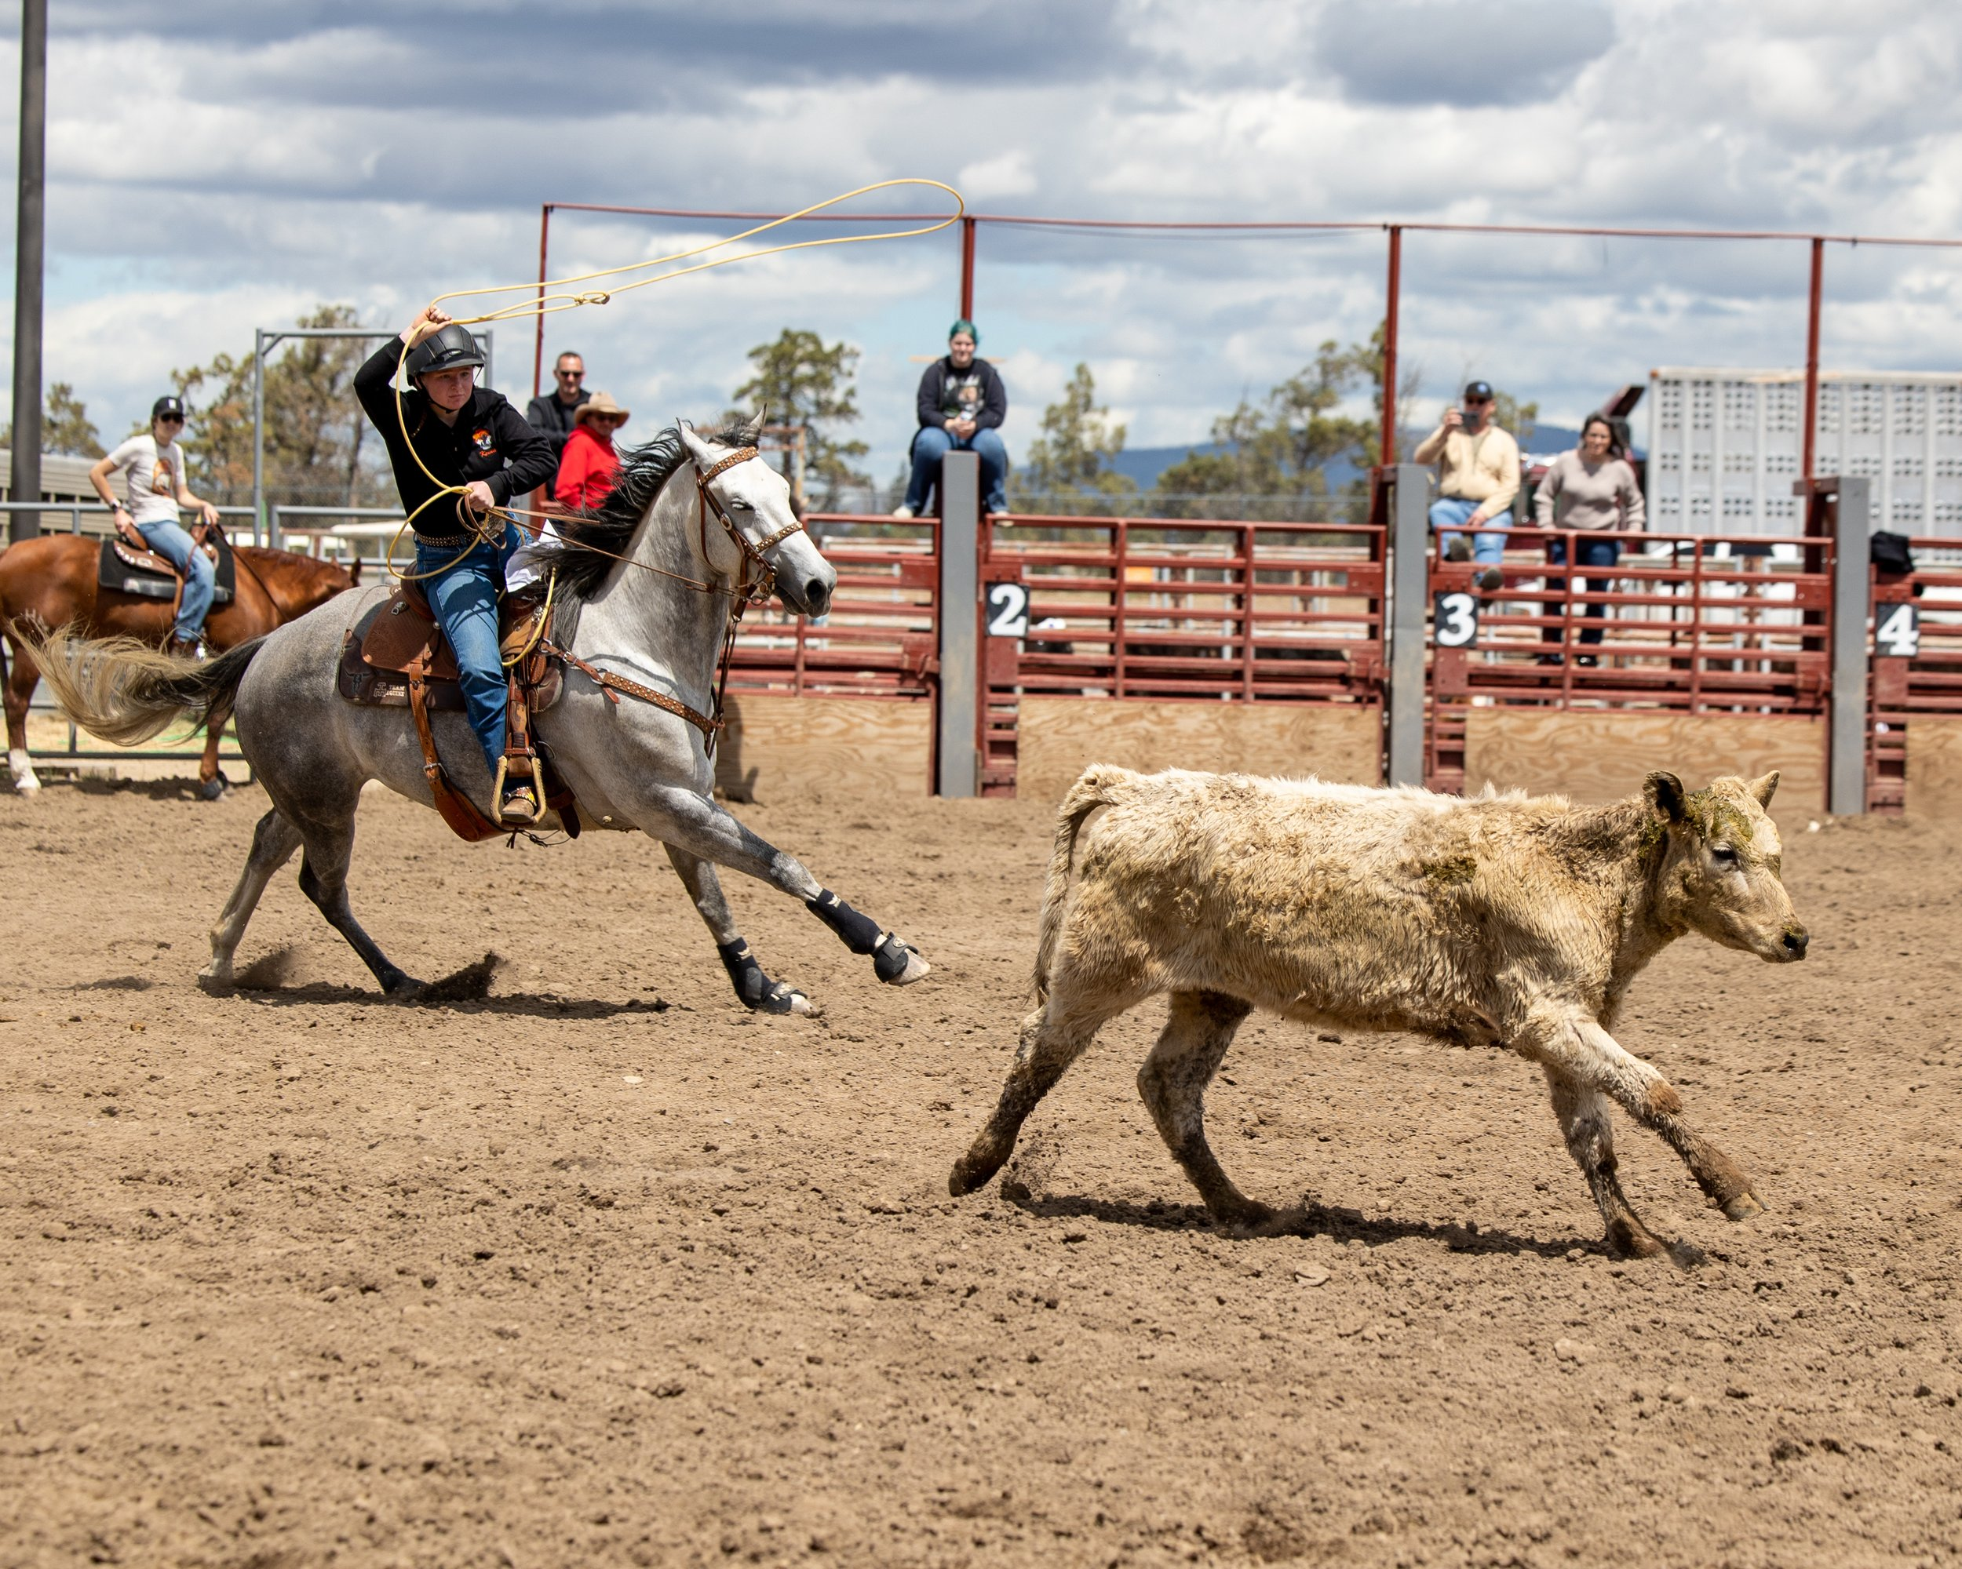
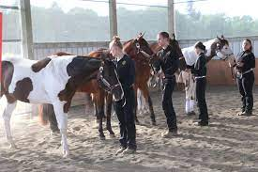
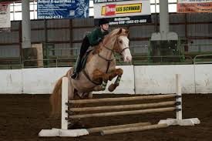
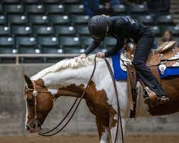
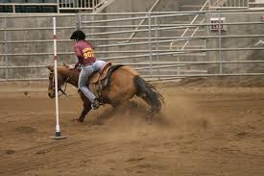
Are you the expert?

Slide 5
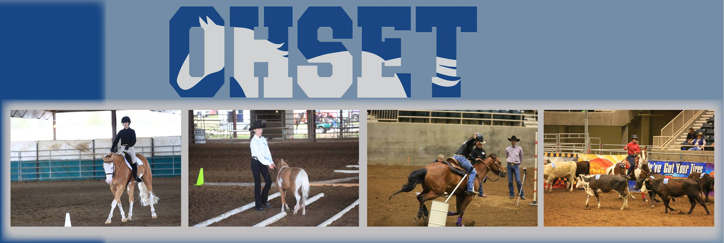
Questions?

