Slide 1


FUNDRAISING:
STATE
DISTRICT
TEAM

Slide 2
STATE fundraising
There are two fundraisers that are
held at the State level.
These fundraisers help keep the State fee low and affordable.
Although fundraisers are not mandatory to participate, we
would greatly appreciate all athletes to participate.
Fred Meyer Community Rewards
$5,000 Vacation Raffle

Slide 3
Fred meyer community rewards
This fundraiser links your Fred Meyer rewards card with the OHSET non-profit rewards.
It doesn’t affect your fuel points or any other rewards you might be earning.
Parents, relatives, neighbors, friends or anyone that has a Fred Meyer rewards card can participate in this fundraiser.

Slide 4
To link your rewards card to OHSET
https://fredmeyer.com/signin?redirectURL=/account/communityrewards/
Choose: Oregon High School Equestrian Teams, Inc as your non-profit
Once you link your rewards card just shop and Fred Meyers will send quarterly contributions to OHSET.

Slide 5
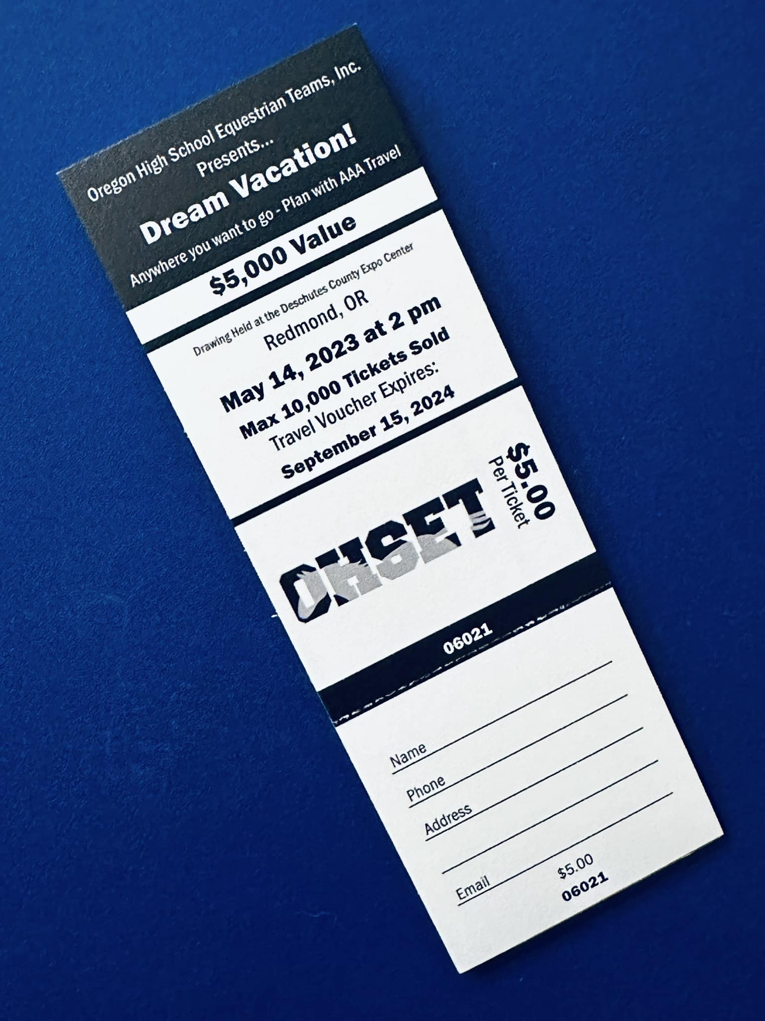
Vacation Raffle
We ask all registered athlete/grooms to try to sell
10 raffle tickets at $5 each. The raffle normally begins in December and the drawing is held during our State Meet.

Slide 6

Once the raffle is complete,
$1 for every ticket sold by
your district will be
sent to your district.
Each district has different timelines
for when unsold tickets and payment
are due so check with your
district for the timelines.

Slide 7
District-Team Raffles
These can be held if you follow the SOG which can
be found on the OHSET website
Resource tab – Rules & SOG’s
District – Team Raffle SOG

Slide 8
District Fundraisers
Oregon High School Equestrian Teams, Inc.
District Chairs
TJ Jones, Blue Mountain
MacKenzie Holland, Central
Jenny Tackett, North East
Kristen Schweitzer, North Valley
Brittany Israel, North West
Sena Conn, South Valley
Kim Ries & Sam Henricks, Co-Chairs Southern
Kevin Wacker, Tri-River Valley
Chloe Burris, Willamette
Every District may have several
fundraisers during the season. They can
range from raffles, wreath sales, desert auctions,
silent auction baskets etc.
Again, we can not force athletes/families to
participate in fundraisers but remember
this is what keep your fees down.

Slide 9
Team Fundraisers
Much like District fundraisers teams can have several types of events raffles, car washes, baked food sales, garage & tack sales, etc.
Again, we can not force athletes/families to participate in fundraisers

Slide 10

Fundraisers can’t be mandatory nor can you
require athletes/families to match
fundraising amounts for not participating.
You can use fundraising as a part of lettering
or year end awards

Slide 11
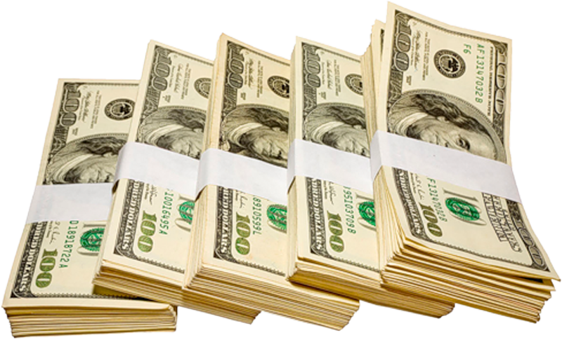
Regardless of participation fundraising proceeds must benefit the entire team equally not just who participated in the event.
Athletes can not be penalized for not participating.

Slide 12

Much like fundraisers sponsorships/donations need to benefit the entire team not an individual. Sponsors need to check with their tax accountant as far as tax deductions.
If a sponsorship is for an individual athlete, it needs to be made to the athlete and given directly to them and not to the team account. This type of sponsorship is not tax deductible.

