Slide 1
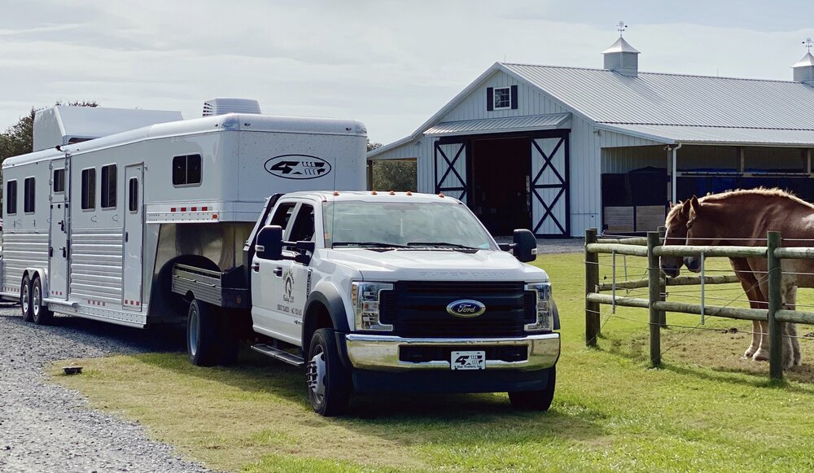
Your Business,
Public Schools and OHSET
Conflict of Interest
Ethics and Integrity
Common Sense Approach

Slide 2
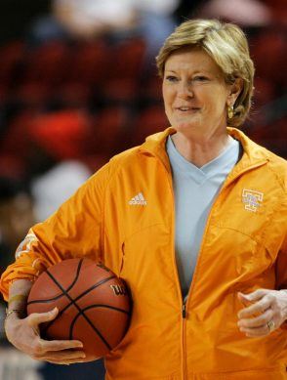
What we MUST Avoid
Prohibited use of position is using or the perception that you are using your official position to avoid financial detriment to any of the above.
This can happen even if a conflict of interest has been disclosed.

Slide 3
Public Official
You as a volunteer of a public school
As a person who volunteers for the school district, you are a public official.
YOU, your business(es) and your immediate family are impacted

Slide 4
Public Official
You as a volunteer of a public school
Your Employer
Your Family
Your Business
Doesn’t matter if you own, have interest in, are an employee, director, agent, etc.
Member of the household: “any person who resides with the public official candidate.”

Slide 5
Potential Conflict of Interest
Disclose
Doesn’t change your responsibility
Potential conflict of interest: any action or any decision or recommendation by a person acting in a capacity as a public official, the effect of which could be to the private financial benefit or detriment of the person or the person’s relative, or a business with which the person or the person’s relative is associated.

Slide 6
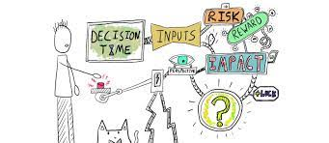
Decision Making Process
Don’t Advocate
Let someone else facilitate if necessary
Team Money – Team Decision

Slide 7
Compensation Package
Can be different per provider or per district
Must be approved by School Board/Officials
Includes monetary and in-kind
All Services
Hauling
Arena
Shirt Sales
Profit NOT an element

Slide 8
Compensation Package
In writing!
Submit to the school
Include “what ifs”

