Slide 1
OHSET Excellence in Equestrian Athletics
Eligibility
2023-24 Coaches & Advisors Training
Hermiston, OR 10/01/23
Springfield, OR 11/18/23

Slide 2
Eligibility
“Is this athlete eligible for our OHSET team (this year or this meet)?”
Who do we ask?
Notes:
We in OHSET often start by ask the wrong question of the wrong people.
Advisor/coach asks District chair “Is this athlete eligible for the OHSET team (this year or this meet)?”

Slide 3
Eligibility - Main Point #1
“Is this athlete eligible for OSAA sports at our school (this year or this meet)?”
Ask the High School Athletic Director
(or designee)
Notes:
Instead, ask the HS AD or designee,
(Main Point #1) “Is this athlete eligible for OSAA Varsity sports (this year or this meet)?”
Because the school has all the eligibility data….

Slide 4
Eligibility can be complex…
Academics
Full Time enrollment
Residency
Satisfactory progress to graduation
Inter-district transfer
5th Yr. Seniors
Charter Schools
Ward of Court
Intra-district transfer
Graduated?
Home School
GED Program
On Line Schools
Continuity of enrollment
Foreign student
Private Schools
Alternative Schools
Co-Ops
Age
Entering 9th grade?
Divorce/Separation
Boarding schools
Duration of Eligibility
Transfers
Prior period total credits earned
Prior period grades
Hardship Exceptions
Class Load
Notes:
Lots of potential data points that could affect eligibility

Slide 5
Oregon High School Equestrian Teams
Is a high school sport, so Students:
Compete for their high school
Are held to the same standards as the other athletes in their school
Strive to earn the same recognition at school
Compete where they are eligible to participate under OSAA rules
Notes:
OREGON HIGH SCHOOL EQUESTRIAN TEAMS
is a High School Sport
so you compete for your high school
are held to the same standards as the other athletes in your school
earn same recognition in your school
where you are eligible to participate under OSAA rules

Slide 6
Why use OSAA?
It is a requirement in OHSET’s Bylaws, Rules & SOGs
Is the standard for High School Sports in Oregon – each state has one. OSAA Founded 105 years ago.
Your school already is a member
Your schools make the OSAA rules
39 athletic districts across the state
Notes:
is the standard for High School Sports in Oregon – each state has one. In 1918, high school administrators met to establish rules on age, amateurism, attendance and scholarship.
they’ve already written a 137 page rule book (like we use horse industry standards)
has the resources to research and maintain and evolve
your school already is a member, and it’s the same rules the other sports in your school abide by
made up of representatives from your schools, except the paid staff.
your schools make the OSAA rules. (Delegate Assembly and Executive board 20-30 athletic districts)
Two main components – Residency and Academics

Slide 7
Eligibility (Residency) - Main Point #2:
Students attend high school where they live, and participate with the high school they attend
Covers the vast majority of situations
Based on curb address of athlete & parents
Which public High School’s attendance boundaries does that curb address fall within in?
That is the HS where the student is normally eligible to participate.
Notes:
Typically eligibility is based on the fact that:
MAP - Based on curb address of athlete/parents. Which public HS’s attendance boundaries does that curb address fall in? That is the HS where the student is eligible to participate

Slide 8
Eligibility (Academics)
Must be enrolled in high school full time
Must have satisfactory grades and be making progress towards graduation
Per OSAA and Individual school/school district requirements
OSAA Rules (same for all)
School/School District rules for OSAA athletes (Can vary between schools/school districts)
Notes:
An eligible student must be enrolled full time and making satisfactory progress (OSAA RULE, Defined by each school!) per OSAA AND local school requirements.
OSAA Rules (same) + School rules for OSAA athletes (Vary between school districts) AND OSAA exceptions may vary, due to 20+ district appeals boards, can’t be totally consistent – OHSET can.

Slide 9
Eligibility - Main Point #1 (again)
Ask, “Is the athlete eligible to participate in OSAA sports at that school?”
Not, “Is the athlete eligibility to participate in OHSET at that school?”
May often get a club sport oriented response, “Sure, we don’t mind.”
Must phrase the question correctly: “Is this student eligible to participate in OSAA sports at this school.”
This will get to the correct answer, very fast, 95% of the time.

Slide 10
8.6.3. Exceptions to Fundamental Rule. (Oregon School Activities Association 2022‐2023 p. 43)
Eligibility (Res.) - Common Exceptions
Entering 9th grade students
Are immediately eligible at the high school they initially enroll in as a freshman, regardless of residency.
Notes:
: Multi high school districts with approvals from both HS and School District (intra-district transfer) between school years.
Exceptions: Between School districts, reciprocal transfers (money moves with child) between school years.

Slide 11
Eligibility (Res.) - Common Exceptions
Intra-District Transfers –
Transfers within a multi-high school district
Approvals from both high schools
Approval from their school district
Transfer is between school years
Notes:
: Multi high school districts with approvals from both HS and School District (intra-district transfer) between school years.
Exceptions: Between School districts, reciprocal transfers (money moves with child) between school years.

Slide 12
Eligibility (Res.) - Common Exceptions
Inter-District transfers - Between school districts
Also called Reciprocal Transfers
Approvals from both high schools
Approval from both school districts
State Funding moves between school districts
Transfer is between school years
Notes:
: Multi high school districts with approvals from both HS and School District (intra-district transfer) between school years.
Exceptions: Between School districts, reciprocal transfers (money moves with child) between school years.

Slide 13
Eligibility (Res.) - Common Exceptions
OHSET Co-Operative Sponsorships
Standard curb address school where student lives, can’t field an OHSET team
Students are eligible for OSAA sports at their curb address school
All eligible at that school and all eligible within that school’s attendance boundaries, will go as one group
Then participate as part of the sponsoring school’s OHSET team (see Co-Op guidelines)

Slide 14
Eligibility (Res.) - Common Exceptions
Private/Public Charter/Alternative Schools
Private/Public Charter/Alternative School may form a team, and then all students attending that school can only participate with that team
OR
Private/Public Charter/Alternative School students participate with the public high school, within whose attendance boundaries their family’s curb address falls within
Notes:
Private schools/Charter schools/Alternative schools - Private school forms a team, and students participate on it, or ride for public HS based on curb address only (see above)

Slide 15
Eligibility (Res.) - Common Exceptions
On Line only Schools
Online Schools do not form teams
Online School students participate with the public high school, within whose attendance boundaries their family’s curb address falls within
Notes:
Private schools/Charter schools/Alternative schools - Private school forms a team, and students participate on it, or ride for public HS based on curb address only (see above)

Slide 16
Eligibility (Res.) - Common Exceptions
Home Schooled Students –
Note: NOT just “going to school from home”
Must meet Oregon law eligibility requirements
Must meet OSAA eligibility requirements
Then based on their curb address:
What public high school’s attendance boundaries does that address fall within?
Home Schooled student may participate with that public high school, or any private high school within that same boundary
Notes:
NOT JUST GOING TO SCHOOL from home!
CREATED AN EXCEPTION FOR MID‐YEAR TRANSFERS WHEN THE SCHOOL OF REPRESENTATION DOES NOT CHANGE. Allows
eligibility to follow students transferring mid‐year between a full member school and an Associate Member school or home
school when the school of representation does not change. (Rule 8.6.6 – Mid‐Year Transfers)

Slide 17
Eligibility (Res.) - Common Exceptions
GED Students (GENERAL EDUCATION DEVELOPMENT)
Must meet Oregon law eligibility requirements
Must meet OSAA eligibility requirements
Then based on their curb address:
What public high school’s attendance boundaries does that address fall within?
GED students may participate with that public high school, or any private high school within that same boundary
Notes:
CREATED AN EXCEPTION FOR MID‐YEAR TRANSFERS WHEN THE SCHOOL OF REPRESENTATION DOES NOT CHANGE. Allows
eligibility to follow students transferring mid‐year between a full member school and an Associate Member school or home
school when the school of representation does not change. (Rule 8.6.6 – Mid‐Year Transfers)

Slide 18
Eligibility (Academics )
Only the student’s school determines OSAA eligibility
Coaches/Advisors check with the high school(s) on OSAA eligibility status (yes/no)
Do not ask for grades or transcripts
Covers both grades earned, and credits earned
Do not try to interpret or make eligibility judgements based on grades or transcripts.
Notes:
An eligible student must be enrolled full time and making satisfactory progress (OSAA RULE, Defined by each school!) per OSAA AND local school requirements.
OSAA Rules (same) + School rules for OSAA athletes (Vary between school districts) AND OSAA exceptions may vary, due to 20+ district appeals boards, can’t be totally consistent – OHSET can.

Slide 19
Eligibility (Academics - Grades)
Enrolled in high school full time
Attending regularly
Passing grades earned in courses at quantity per chart below:
And, these requirements also apply for the immediate preceding grading period
Notes:
An eligible student must be enrolled full time and making satisfactory progress (OSAA RULE, Defined by each school!) per OSAA AND local school requirements.
OSAA Rules (same) + School rules for OSAA athletes (Vary between school districts) AND OSAA exceptions may vary, due to 20+ district appeals boards, can’t be totally consistent – OHSET can.

Slide 20
Eligibility (Academics - Credits)
Must be making satisfactory progress towards their school’s graduation requirements for credits earned per chart below:
“On Track To Graduate – Total Credits earned”
Notes:
An eligible student must be enrolled full time and making satisfactory progress (OSAA RULE, Defined by each school!) per OSAA AND local school requirements.
OSAA Rules (same) + School rules for OSAA athletes (Vary between school districts) AND OSAA exceptions may vary, due to 20+ district appeals boards, can’t be totally consistent – OHSET can.

Slide 21
Eligibility (Academics) Home School
Home school student notifies the local ESD prior to the first day of school
Take achievement test annually at the end of the school year (by August 15)
Achieve a minimum score (23rd percentile).
The test is NOT required of home school students when entering the 9th grade
No “grade” reporting thru the OHSET season
Work Sample Alternative in absence of achievement test results, IF school district adopts alternative requirements (portfolio of work samples).
Notes:
An eligible student must be enrolled full time and making satisfactory progress (OSAA RULE, Defined by each school!) per OSAA AND local school requirements.
OSAA Rules (same) + School rules for OSAA athletes (Vary between school districts) AND OSAA exceptions may vary, due to 20+ district appeals boards, can’t be totally consistent – OHSET can.

Slide 22
Eligibility (Academics) GED
GED student notifies the local school or ESD prior to the first day of school
GED student shows that, prior to beginning the interscholastic activity each year (11/1 for OHSET), they have passed at least one practice test administered through the GED program.
No “grade” reporting thru the OHSET season
Notes:
An eligible student must be enrolled full time and making satisfactory progress (OSAA RULE, Defined by each school!) per OSAA AND local school requirements.
OSAA Rules (same) + School rules for OSAA athletes (Vary between school districts) AND OSAA exceptions may vary, due to 20+ district appeals boards, can’t be totally consistent – OHSET can.

Slide 23
Eligibility - Main Point #3
If Not Normally eligible, NOW WHAT?
Will need an exception to participate with that school
Go through OSAA process for eligibility waiver/exception, if doing OSAA sports also
Go through OHSET process for eligibility waiver/exception
Exception requests go to OHSET State Board for review and vote on approval/disapproval
Notes:
Great if can go through OSAA process for waiver/exception, if student is going to do OSAA sports also. If not, would need OHSET State Board Exception to participate, typically brought by district chair with District’s indication of support/nonsupport.

Slide 24
Eligibility Exception Tree (standard)
Federal law - IRS 501c3 (NO OHSET Exceptions)
Oregon Law – Statutes (NO OHSET Exceptions)
OHSET – Bylaws OSAA Eligibility Rules (OHSET State Board Oks Exceptions)
OHSET – Rules (OHSET State Board Oks Exceptions)
OHSET – SOGs (OHSET State Board Oks Exceptions)
Notes:
We in OHSET often start by ask the wrong question of the wrong people.
Advisor/coach asks District chair “Is this athlete eligible for the OHSET team (this year or this meet)?”

Slide 25
Exception Tree (Homeschool/GED/Public Charter)
Federal law - IRS 501c3 (NO OHSET Exceptions)
Oregon Law – Statutes (NO OHSET Exceptions)
OHSET – Bylaws OSAA Eligibility Rules (OHSET State Board NO Exceptions)
OHSET – Rules (OHSET State Board Oks Exceptions)
OHSET – SOGs (OHSET State Board Oks Exceptions)
Notes:
We in OHSET often start by ask the wrong question of the wrong people.
Advisor/coach asks District chair “Is this athlete eligible for the OHSET team (this year or this meet)?”

Slide 26
ORS 339.460 (7)
A [GED] high school equivalency student, a homeschooled student or a student who attends a public charter school who participates in interscholastic activities must reside within the attendance boundaries of the school at which the student participates unless the school district has a policy that allows any student attending a school of the school district to participate in interscholastic activities at any school of the school district.
Notes:
We in OHSET often start by ask the wrong question of the wrong people.
Advisor/coach asks District chair “Is this athlete eligible for the OHSET team (this year or this meet)?”

Slide 27
Hardship Definition:
Q. What is meant by “circumstances beyond the control of each of the student and the student’s parent(s)”?
A. When considering a hardship request, it is always an integral part of the evaluation to determine whether the events are outside a student or student’s parent(s) control, or whether the choices/decisions/actions that created the eligibility problem included knowable/predictable eligibility outcomes or consequences. Requests are denied when it appears the student’s eligibility situation has come about as a result of choices, decisions and/or actions made by the student, or the student’s parents(s), or both.
Notes:
We in OHSET often start by ask the wrong question of the wrong people.
Advisor/coach asks District chair “Is this athlete eligible for the OHSET team (this year or this meet)?”

Slide 28
Eligibility - Main Point #3 (cont.)
If not eligible, but allowed to participate?
Considered cheating (Never a good lesson to teach our youth!)
OHSET insurance not in effect, so you assume all liability
Any points earned may be forfeited, including team points
Potential further penalties
Notes:
If not eligible, but allowed to participate
Cheating (Never a good lesson to teach our youth!)
OHSET insurance not in effect, so you assume liability
any points earned forfeited, including team points
potential further penalties.

Slide 29
Eligibility thru the Season
Where possible, use weekly academic check list that is used for OSAA athletes in your school.
Same eligibility requirements as for OSAA athletes at your school.
Varies widely from school to school or school district to school district, so CHECK!
May not be the same from OHSET team to OHSET team within an OHSET district.
Follow OHSET and the High School’s code of conduct
Notes:
HOW SCHOOL RULES APPLY / ATTENDANCE REQUIREMENTS per school
Once eligible to begin with, what about eligibility as go through the season? (typically grades/or behavior) - Follow OHSET and the High Schools code of conduct
Same eligibility requirements as for OSAA Varsity athletes at that school.
Wide variation from school to school, and/or School district to school district, so CHECK!
May not be the same from OHSET team to OHSET team within an OHSET district.
Use weekly academic check list as used for OSAA athletes in that school.

Slide 30
Eligibility thru the Season -
Private/Charter/ Alternative/On-Line schools
Academic checks come from the school the student attends, not their OHSET team’s school
Private/Charter/ Alternative/On-Line schools are members of OSAA - Full Member (297) or Associate Member (114)
Someone at that school (Athletic/Activities Director/Principal), would relay to coach/advisor “yes/no” on OSAA eligibility on request
www.osaa.org/schools shows member schools, with contact information
Notes:
An eligible student must be enrolled full time and making satisfactory progress (OSAA RULE, Defined by each school!) per OSAA AND local school requirements.
OSAA Rules (same) + School rules for OSAA athletes (Vary between school districts) AND OSAA exceptions may vary, due to 20+ district appeals boards, can’t be totally consistent – OHSET can.

Slide 31
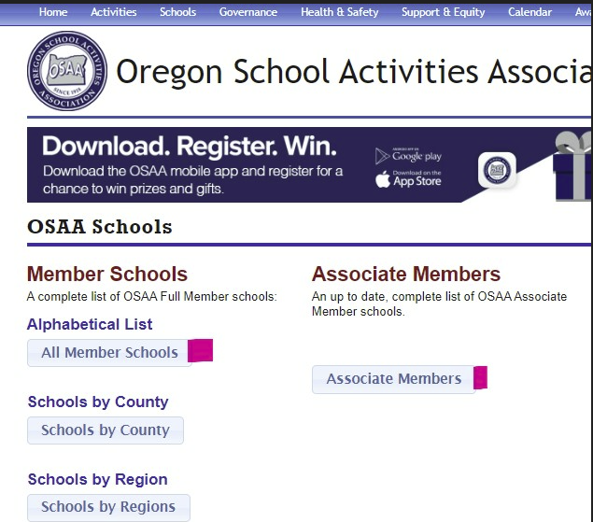
OSAA School Lists
Notes:
An eligible student must be enrolled full time and making satisfactory progress (OSAA RULE, Defined by each school!) per OSAA AND local school requirements.
OSAA Rules (same) + School rules for OSAA athletes (Vary between school districts) AND OSAA exceptions may vary, due to 20+ district appeals boards, can’t be totally consistent – OHSET can.

Slide 32
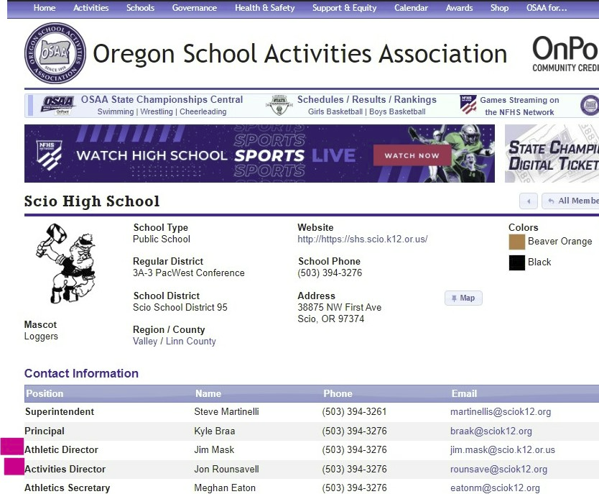
OSAA School Lists
Notes:
An eligible student must be enrolled full time and making satisfactory progress (OSAA RULE, Defined by each school!) per OSAA AND local school requirements.
OSAA Rules (same) + School rules for OSAA athletes (Vary between school districts) AND OSAA exceptions may vary, due to 20+ district appeals boards, can’t be totally consistent – OHSET can.

Slide 33
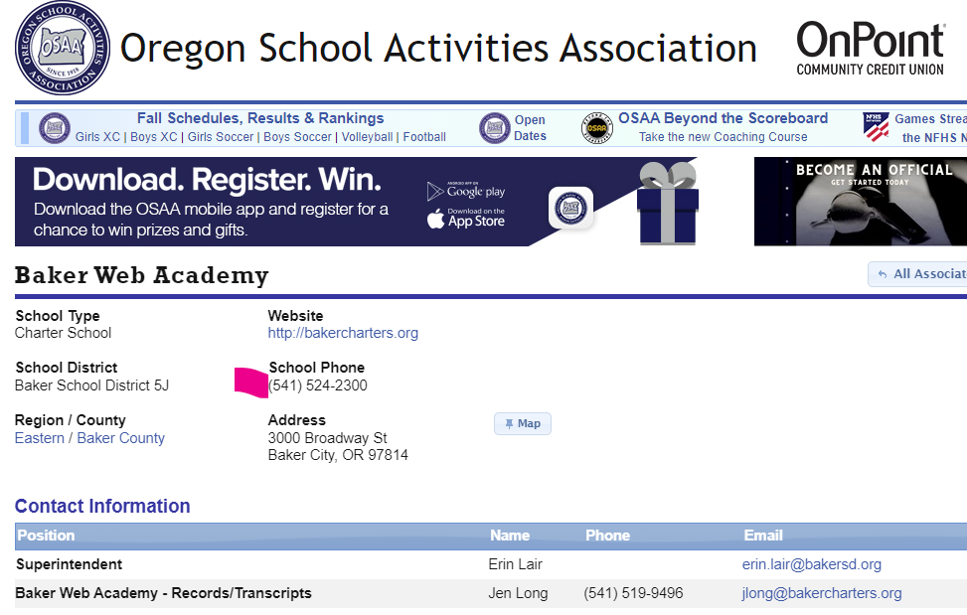
OSAA School Lists
Notes:
An eligible student must be enrolled full time and making satisfactory progress (OSAA RULE, Defined by each school!) per OSAA AND local school requirements.
OSAA Rules (same) + School rules for OSAA athletes (Vary between school districts) AND OSAA exceptions may vary, due to 20+ district appeals boards, can’t be totally consistent – OHSET can.

Slide 34
Athletic Director – Build a relationship
Get to know them, get on their good side
Same for the admin person in charge of the detail work on eligibility lists each week for OSAA athletes
Get your athletes on that list
Invite your Principal, Athletic/ Activity Director and Booster Club President to your practices or meets
Volunteer your team and parents for school projects - the more visible the better!
Notes:
Athletic Director – Build a relationship ( # of positive contacts, # negative contacts)
get to know them, get on their good side,
also with the person who does the detailed work on eligibility lists each week for OSAA athletes detail list that goes to teachers (office administration, secretaries, etc.)
get your athletes on that list
Volunteer your team and parents for school projects, the more visible the better.
Get with your school’s booster club, and volunteer your team and parents for fundraisers/work.
will likely become eligible for some funding from the Booster Club
Raise positive visibility of the OHSET team within the school

Slide 35
Athletic Director Relationship (cont.)
Get involved with your school’s booster club
Volunteer your team and parents for fundraisers/work.
May become eligible for funding from the Booster Club
Raise positive visibility of the OHSET team within the school!

Slide 36
Eligibility Review -
Main Point #1 (one more time)
“Is this athlete eligible for OSAA sports at our school (this year or this meet)?”
Ask the High School Athletic Director (or designee)
Notes:
(Main Point #1, again) Ask the HS AD or designee, “Is this athlete eligible for OSAA Varsity sports (this year or this meet)?”

Slide 37
Eligibility - Questions?
Bill Weir
Eligibility and Co-Ops
541-221-0303
bweir@ohset.com
Notes:
(Main Point #1, again) Ask the HS AD or designee, “Is this athlete eligible for OSAA Varsity sports (this year or this meet)?”

