Slide 1
Dealing with Difficult People
And the Conflict that Comes with It

Slide 2
Difficulty
Identify the

Slide 3
Power Monsters
People who feed on power and are driven to control people as well as situations.

Slide 4
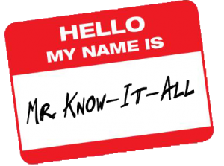
Answer Guys
People who know everything, just ask them.

Slide 5
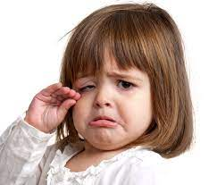
Whiners
People who complain incessantly, and that’s all they do

Slide 6
Manipulators
Expert deceivers who seldom give all the facts

Slide 7
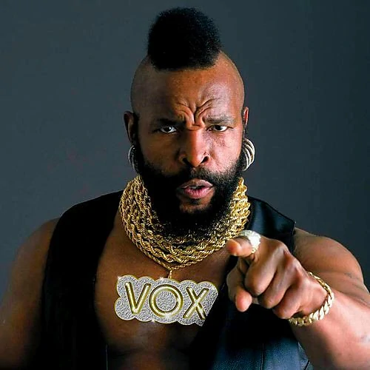
Tough Guys
People who bully others, make cutting remarks and throw tantrums

Slide 8
Others
Others might include:
Unresponsive
Wishy-washy
Always agreeable

Slide 9
Perspective
Keeping

Slide 10
Importance!
Just because it’s not important to you, doesn’t mean it’s not important

Slide 11
Facts Only
Address issues and facts, NOT people.

Slide 12
Change…NOT
Don’t expect people to change; they are not likely to change; AND this can be a good thing, it makes them more predictable

Slide 13
Less Emotions
Whenever possible, leave out the emotions

Slide 14
Plan
Have A

Slide 15
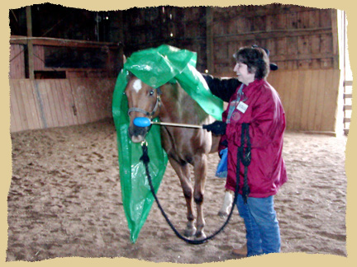
Why We Avoid Confrontation
Fear of injury
Fear of failure
Fear of hurting others’ feelings
Fear of rejection
Fear of financial impacts

Slide 16
Squashing the Fear

Slide 17
Ask Questions
Be specific about the situation or about why “we’re at this place…

Slide 18
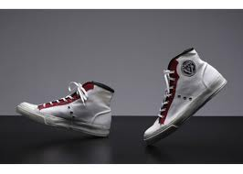
Try to Understand the Person
See the situation from their view; and remember there are lots of things going on in peoples’ lives besides this current issue

Slide 19
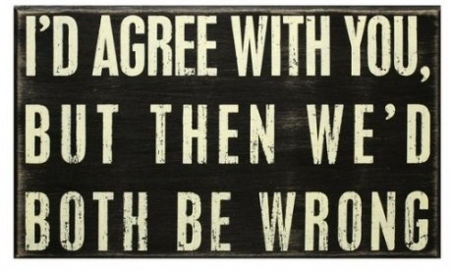
Clear Facts
Be certain the facts of the situation are clear, agree on as much as possible

Slide 20
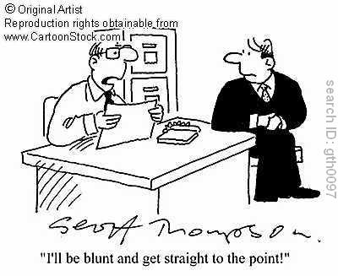
Directness
Deal with the person directly and discreetly if possible

Slide 21
Straightforward and Unemotional
Some issues are emotional and sometimes you are the only non-emotional party; it’s hard, but worth it

Slide 22
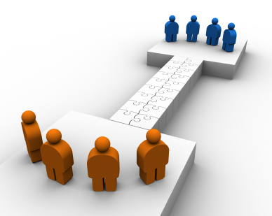
Find Common Ground
Find something you can agree on, even if it’s as simple as “great weather we’re having…”

Slide 23
Listen!
Probably the most crucial element

Slide 24
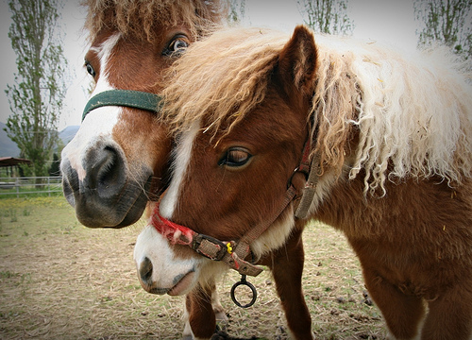
Share your feelings
While we’re keeping emotions out, you obviously have feelings about the situation, behavior, etc. It’s OK to share

Slide 25
Be Gracious
Webster defines Gracious as…
“kind and pleasant in manner,…” “…merciful.”
I have heard it said, “If you have to choose between being right and being kind, always choose kind.”

Slide 26
Respond
Versus reaction

Slide 27
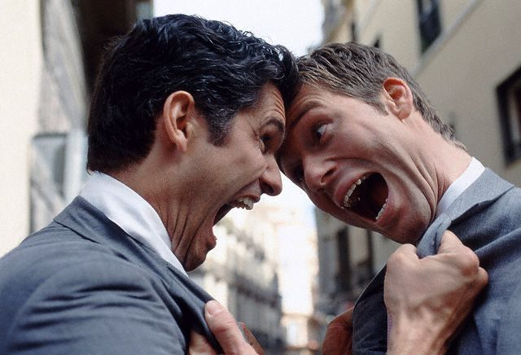
Know Yourself
Often difficult situations escalate because of our response or reaction.

Slide 28
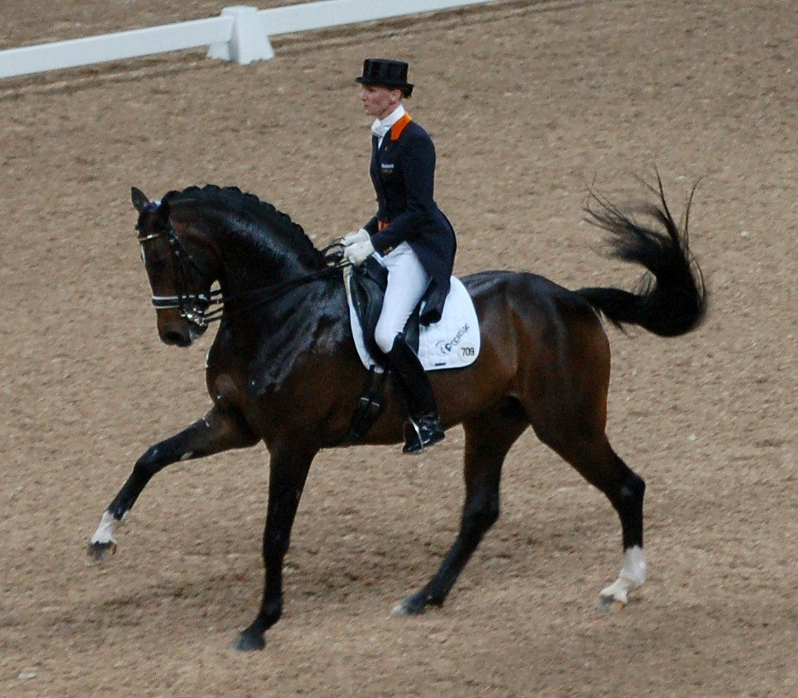
Skilled Responses
Teach yourself to have skilled responses

Slide 29
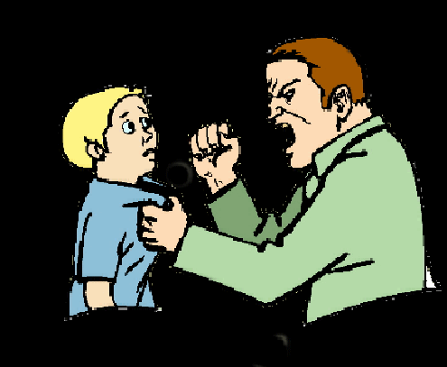
Know Your “HOT” Button
Have coping strategies for dealing with reactions to things that you might perceive as a threat

Slide 30
Having the Last Word
Is having the last word really so important?
Let it go… move on – this will help others do the same

Slide 31
Conflict
Dealing with the most serious of

Slide 32
What is Conflict?
“1. a fight, a struggle. 2. disagreement between people with different ideas or beliefs.” (Oxford 179)

Slide 33
Sit Down
It’s much harder to be angry sitting down.

Slide 34
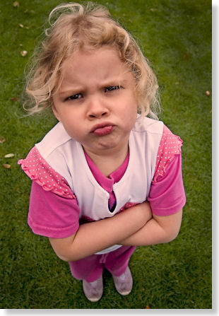
Send the Right Message with Your Body Language too!

Slide 35
Listening
The single most important key to conflict resolution.
My father says “It’s better to remain silent and be thought of a fool, than to speak and remove all doubt.”

Slide 36
Keys to Good Listening
The simple appearance of your listening can be beneficial.
Ask questions. This demonstrates you are listening and can clear up any misunderstandings.
Listen actively, so you can understand.
Most important,
A closed mouth.

Slide 37
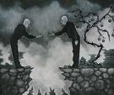
Find Some Common Ground
It’s always helpful to find something both parties can agree on.
For example:
You want what’s best for their child
What a beautiful day
Great weather,

Slide 38
Know How You Will React
It’s easiest to resolve conflict if we know what and why we feel the way we do. Most of us have hot buttons, know what they are and how you will respond. Understanding ourselves, makes it easier to share that information with others and helps us to concentrate on understanding the other person.

Slide 39
Be Honest. Articulate Clearly.
Often called assertive communication, it’s a way to say what’s on your mind clearly and straightforward without being aggressive or criticizing the other person in some way.

Slide 40
Work for a Solution
Once you have a clear understanding of the problem, try to come up with a solution. Don’t be afraid to ask the other person what the best possible solution for them is AND don’t be afraid to tell them, what is NOT a possibility.

Slide 41
Know When to Stop
If your best skills aren’t working, shut it down. Sometimes people have to agree to disagree or sometimes simply walk away without solution. When someone has nothing new to add and no solutions are possible, it’s time to walk away.

Slide 42
Communication
It’s really the key.

Slide 43
Choose to communicate in a way that works
If it’s not working, try another approach.
Remember, it’s not personal, it’s an exchange of information…work toward the solution.
Focus on the issue.
It’s not a conspiracy to make you have a bad day.

Slide 44
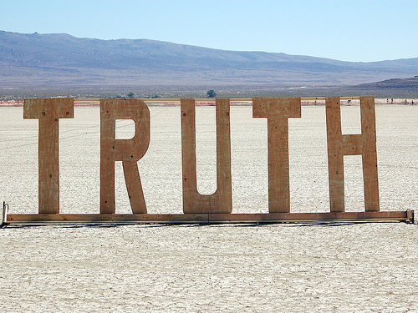
If all else fails, tell the truth.
The truth is personal and contains I statements.
I’m doing the best I can.
I don’t deserve to be shouted at
It’s true, I haven’t called you back
Acknowledge the accuracies.

Slide 45
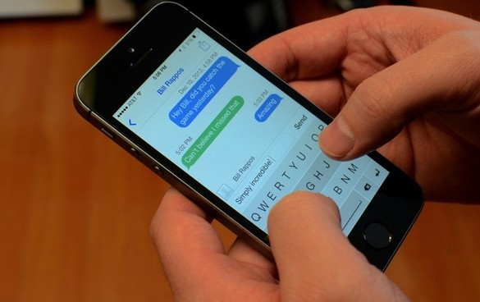
Choose your mode of communication carefully
Email is not a good way to resolve conflict.
Face to Face discussion is best.
Phone conversation if face to face isn’t possible.

Slide 46
If you use Email…
Proofread!
Remember, it’s a written record.
Consider who and where you are sending it.
Don’t forward an email without permission from the original sender
IT’S NOT A GOOD CHOICE FOR CONFLICT RESOLUTION.

Slide 47
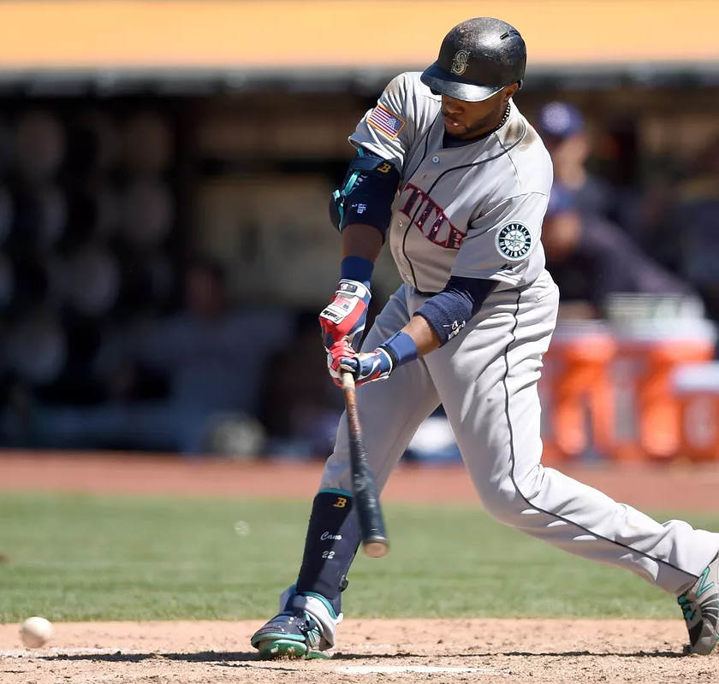
Don’t Swing at a Pitch in the Dirt
Ignore negative energy and rude disrespectful comments. They don’t deserve or need a response.
Don’t be afraid to absorb some of their energy by saying things like: “you might be right…,” “You have a point…,” “Hmm, I haven’t considered that…”
Deflect energy by using humor only if it comes naturally and is appropriate.

Slide 48
Keep it in Perspective
Just because the issue isn’t important to you, doesn’t mean it’s not important.
Address issues and facts, not people.
Leave the emotions out.

Slide 49
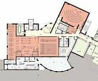
Have a Plan
Know how you’re going to respond.
Teach yourself to have skilled responses.
Know what threatens you, learn to stop when you’re becoming defensive.
Own your part of the problem.
Be as discreet as possible.

Slide 50
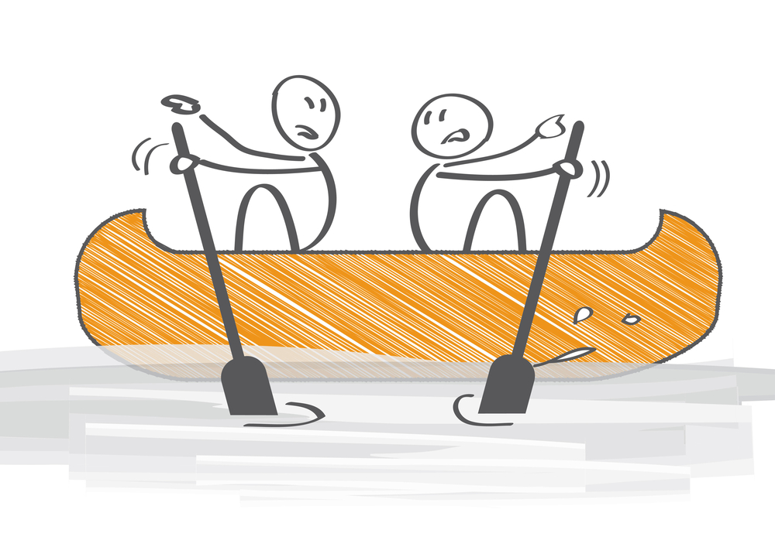
What Conflict is NOT.
It’s not a hatred or an emotional feeling. People can have disagreements or conflict and still like each other and/or care about each other and respect each other.

Slide 51
Resolving Conflict
Some things you may want to avoid

Slide 52
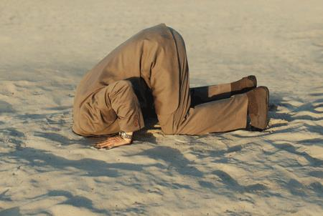
Avoiding Conflict Altogether
Letting things build up contributes to explosiveness and perpetuates challenges. Suddenly (or not so suddenly) the conflict resembles the snowball effect.

Slide 53
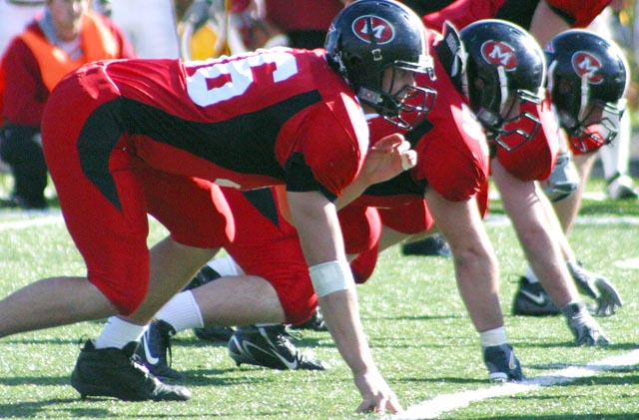
Being Defensive
Try not to let it be about you, try to let it be about the issue. This will help you not to be defensive. Accept and try to understand the other side, without feeling the need to defend yours.

Slide 54
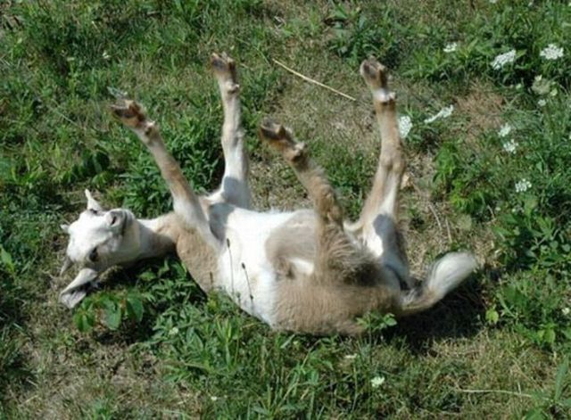
Dramatizing
When we feel hurt, misunderstood or disagree, we often want to generalize or dramatize the issue. For example, using words like “everyone is mad…” or “everything is all messed up…” or “you always come home late.”

Slide 55
Being Right
Someone once said to me, “if faced with a choice of being right or being kind, choose kind.”
There are many perspectives to issues, this does not necessarily mean there is a right and a wrong way to view it.

Slide 56
Reading Between the Lines
Don’t decide you know how someone is feeling. For example if someone is late, try not to assume it’s because they don’t care – ask! Don’t attempt to read their mind or assume.

Slide 57
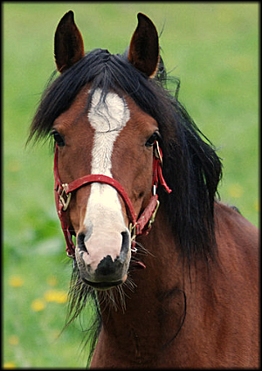
Don’t Forget to Listen
Often we get so focused on what we want to say next or the point we MUST get across, that we fail to listen. Listening is the most critical element to resolution.

Slide 58
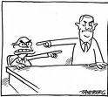
Lacking Accountability
It’s easy to blame someone else. The other person, a third party, anyone as long as it’s not us. It’s important we take responsibility for our part.

Slide 59
Competing
Trying to “win” the argument does not solve the challenge. This focus also diminishes listening. Work toward understanding and listening, not winning.

Slide 60
Attacking
Resolving conflict does not include attacking the other person or their character. Saying things like “you’re an idiot,” “you don’t have any compassion,” etc. – this will create defensiveness on the other side and loses site of the focus of the discussion

Slide 61
Refusing to Discuss the Issue
Much like avoiding conflict, stonewalling the issue is also not productive. Solutions and/or healing can not begin if issues are not addressed.

Slide 62
Quick List
Clarify the issue
Ask questions
Listen
Put it in perspective
Leave out the emotion
It’s NOT personal
Understand all sides
Be tactful
Don’t get defensive
Know how YOU will respond
Be direct
Be discreet
Don’t expect them to change
Be straightforward

Slide 63
What Kinds of Conflict Are Most Common in the OHSET Community?
What do you mean my child got DQ’d?
Nobody told me that was the rule.
My child couldn’t make it to the class, they overslept.
I don’t have time to make that many meetings.
You’re always picking on my kid.

Slide 64
Questions
Some of this has been redundant in an effort to say it another way…
Did we miss anything?
Any questions?
Challenges we didn’t cover?

Slide 65
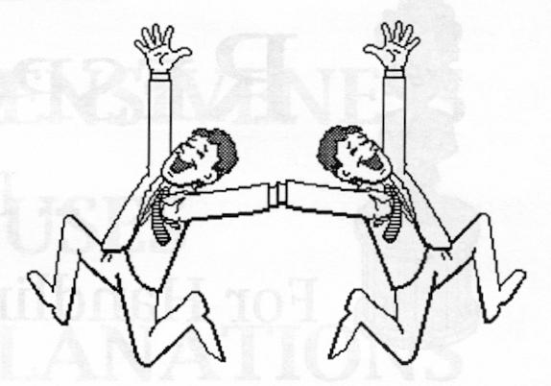
Practice!
And don’t expect to be perfect every time. Even the most skilled conflict managers don’t always find resolution.

Slide 66
Hostility & Anger
Simple tips for dealing with

Slide 67
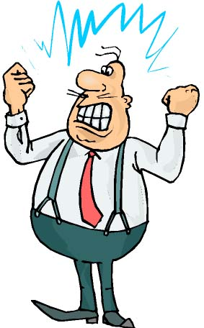
Response
When anger is directed at us, we often respond with anger or we retreat and let them “hammer” us. As long as either of these is happening, there is no focus on the real issue.

Slide 68
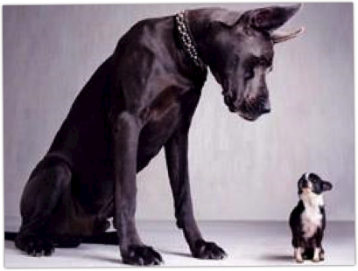
Goals
The goals of an angry person are either to force respect or intimidate

Slide 69
What NOT to do
Don’t just let it go
This often will result in an accumulation and a loss of control. Appearing weak or getting angry usually have equal results; an escalation of the tirade and the angry either “go for the kill” or become threatened.
Don’t make promises you can’t keep

Slide 70
TRY THIS
Appear firm, strong, and unemotional. Use tact and a steady quiet, but deliberate voice; this will often get their attention and respect. Ask good questions that are pertinent to the issue, try to be friendly. Get the facts. Let them know you know they are upset. Repeat their issues back to them to be sure you understand. Ask what you can do to resolve the issue.

Slide 71
rudeness
Simple tips for dealing with

Slide 72
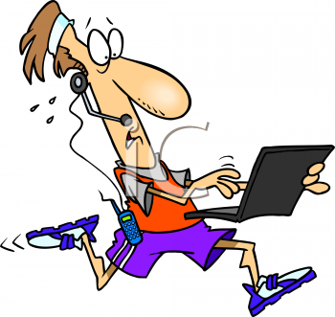
Most common rude behavior
If you are trying to converse with someone and they are busy doing something else…

Slide 73
What NOT to do
Don’t Compete

Slide 74
What to do
Ask if they would like you to come back another time; and politely excuse yourself
Ask questions to see if they’re listening
Get them involved by having to express themselves

Slide 75
Closed minds
Simple tips for dealing with

Slide 76
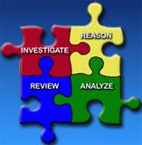
Closed Mindedness
Closed minded people miss out on tons of cool stuff

Slide 77
What NOT to do
Don’t expect them to change

Slide 78
Try this…
Try and understand their point of view
Explain the mutual benefits of your plan
Acknowledge the obstacles
Demonstrate (show evidence of ) the need for change

Slide 79
communication
The key is

Slide 80
Simple tips
Use “I” messages… I really need X to happen
Be conscience of your body language
Make sure you get and give a clear message
Ask questions for clarity AND so the speaker knows you’re listening
LISTEN!!!!!!!

Slide 81
The least you should know
About dealing with difficult people and conflict resolution

