Slide 1
10 15 16 17 19 ...20 Random Things
We Want to Talk About!

Slide 2
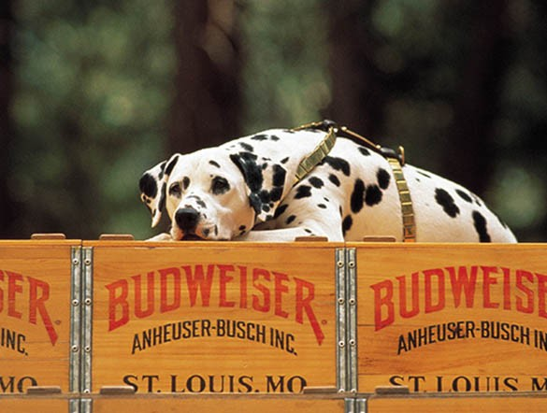
The DRINK
At practice
At meets
Coaches
Parents
Youth

Slide 3
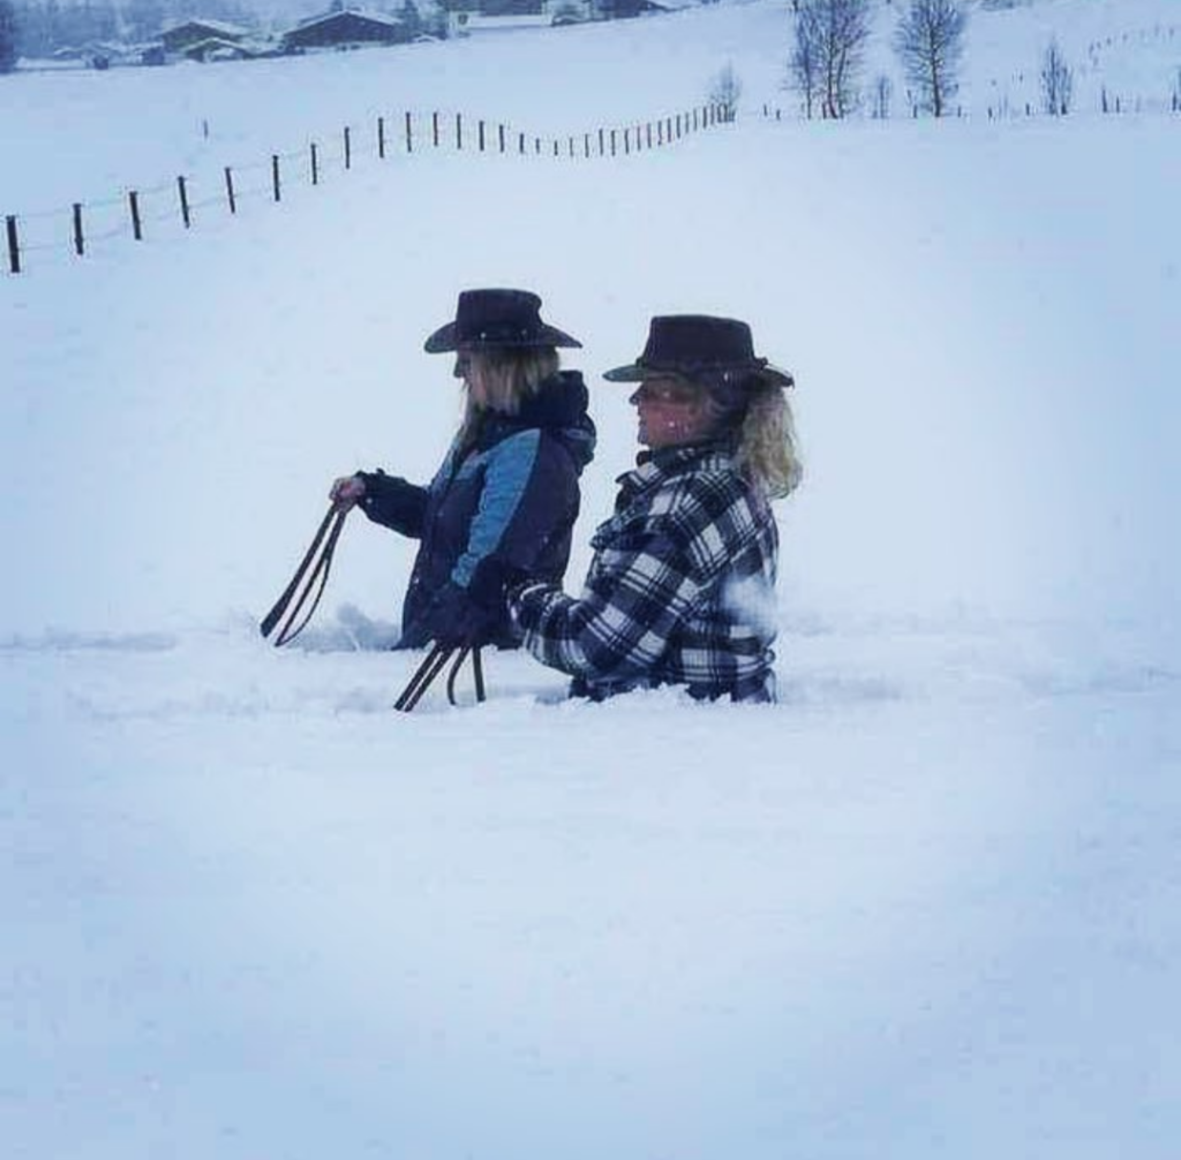
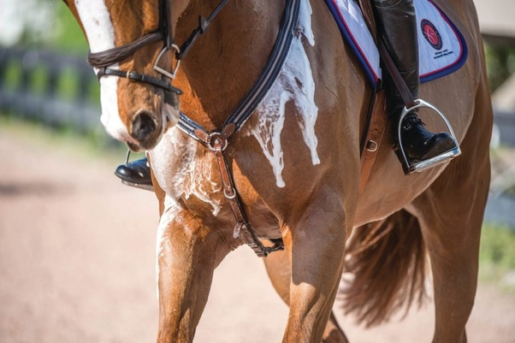
Practice Length - Effectiveness
How long is too long
Heat/Cold
Mandatory
Make it work for you
Try to have it work for as many participants as possible
Add coaches
Utilize other opportunities

Slide 4
Touching – Displays of Affection
What’s appropriate?
What isn’t
Reporting
Youth
Adults
Volunteers

Slide 5
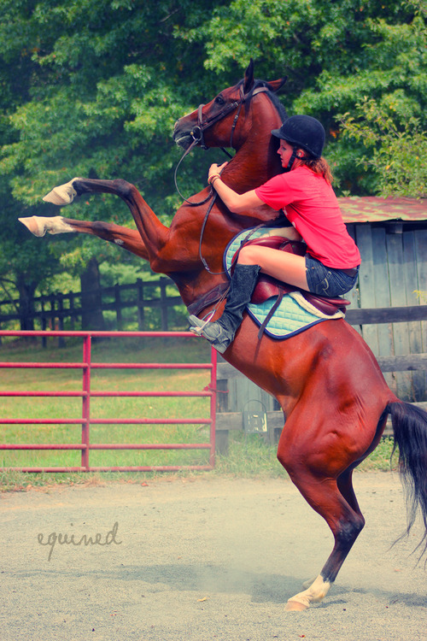
Riding Athlete’s Horses
Not a good idea
When might it be a good idea
Not part of the coaching job

Slide 6
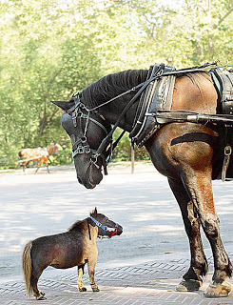
Chaperoning Youth at Meets
Should be a requirement at all districts
Youth should never be camping alone

Slide 7
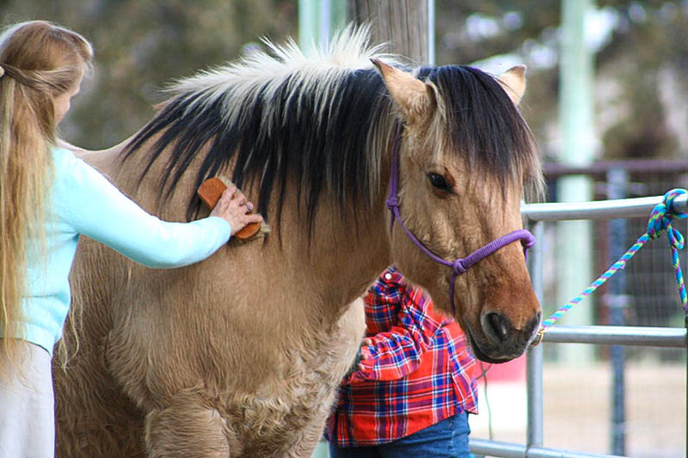
Respect all Skill Levels & Disciplines
All levels and disciplines are welcome
Find events that they can manage and keep them safe!

Slide 8
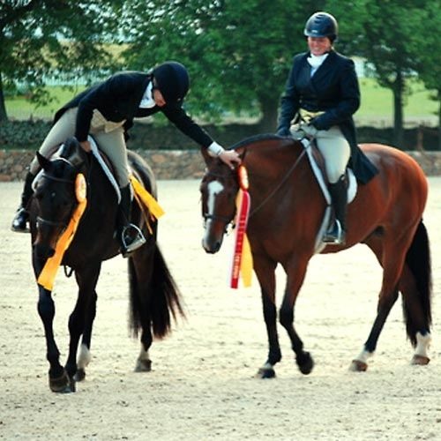
Be Courteous and Respectful
Other coaches
Youth
Parents
Volunteers
Judges
The Public
Rules
Facilities
Contractors

Slide 9
Volunteers are a MUST
Let your parents know that volunteering is part of their responsibility
Many hands make light work

Slide 10
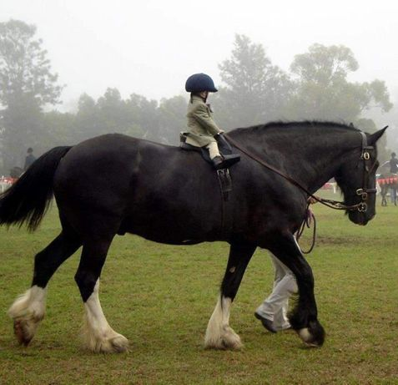
Inexperienced riders – too much horse!
Over-mounted
Accidents
Insurance
Responsibility
Safety

Slide 11
Know the Rules
Rule Book
Standard Operating Guidelines
Facilities
District
Team
School

Slide 12
Report!
All accidents
Practice or Meets
All Significant Discipline Actions to your district chair

Slide 13
Team Funds
Don’t let team funds be an issue
Keep them transparent
Accurate
Detailed
Timely Reporting

Slide 14
Treat all team members equally
Paying students vs team members
Skilled vs lessor skilled
Friends vs non-friends
Good horses vs challenging
Protected Classes

Slide 15
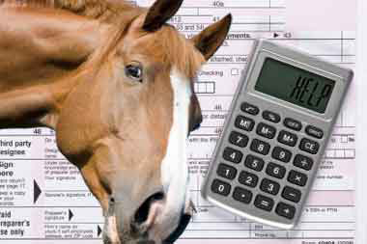
Using OHSET to Expand your business
Use of YOUR Arena
Hauling Horses
Giving Lessons
Boarding Horses
Leasing a Horse

Slide 16
Communicate!!!
With your district chairs
With other coaches
With your team members AND their parents
With donors, sponsors, and funders
With facility owners
With your School, AD, and other school representatives

Slide 17
Promote Ohset Not its problems

Slide 18
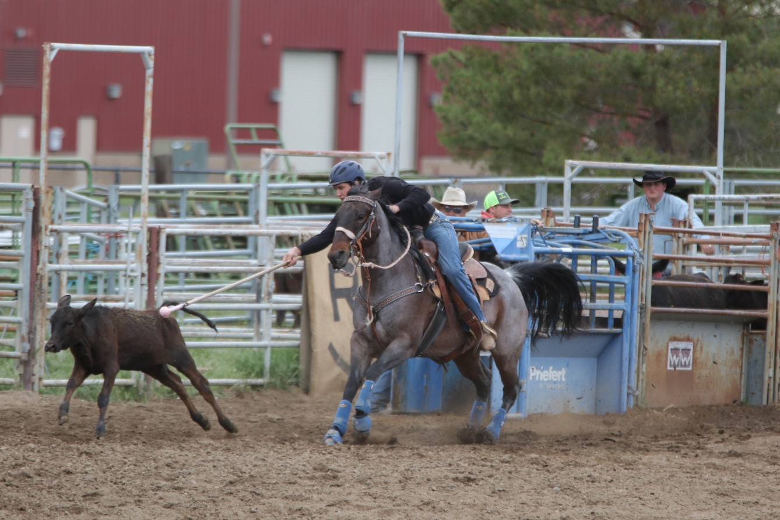
Create a relationship at the school!

Slide 19
Selling raffle tickets is a part of ohset

Slide 20
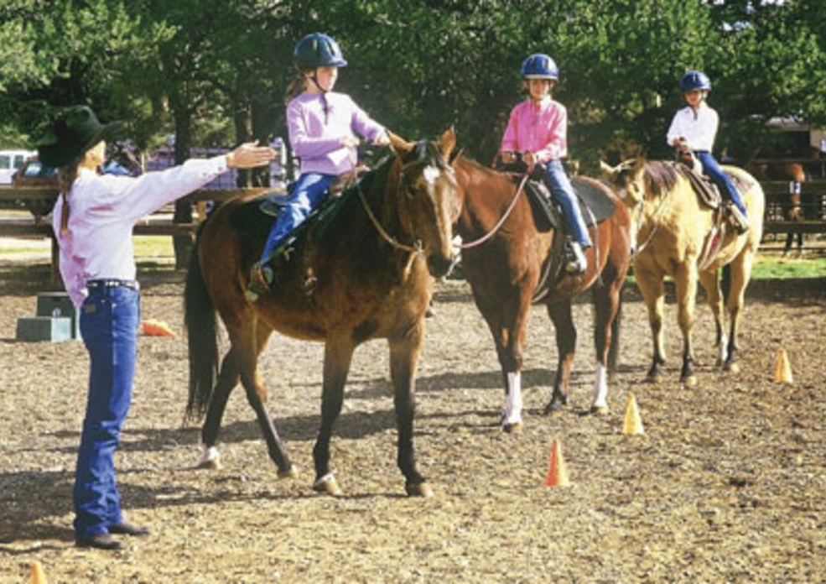
8th Graders, OHSET, and eligibility

